Slide 1
C# Programming
Class Outline
Lecturer
Student
Course

Slide 2
Lecturer
Jordan Balintac
Senior Software Developer
Magenic Manila Inc.
4 year industry experience
1 year teaching experience
STI Ortigas-Cainta

Slide 3
Student
Name
Work Experience
Programming Knowledge
Ice breaker (Interesting trivia about you)

Slide 4
Course Outline
See outline
Lecture and Application
Assignment for the next morning
Module Quiz
Case Study

Slide 5
Introduction to .NET
Lesson 1
Basic .Net Concepts
Exploring the .Net Environment
Creating Simple Windows Application Project

Slide 6
.NET Framework
Developer(s) | Microsoft
Initial release | 13 February 2002; 15 years ago
Stable release | 4.7 / 5 April 2017; 2 months ago^{[1]}
Operating system | Windows 98 or later, Windows NT 4.0 or later
Type | Software framework
License | Mixed; see § Licensing
Website | microsoft.com/net
Notes:
.NET Framework (pronounced dot net) is a software framework developed by Microsoft that runs primarily on Microsoft Windows. It includes a large class library named Framework Class Library (FCL) and provides language interoperability (each language can use code written in other languages) across several programming languages. Programs written for .NET Framework execute in a software environment (in contrast to a hardware environment) named Common Language Runtime (CLR), an application virtual machine that provides services such as security, memory management, and exception handling. (As such, computer code written using .NET Framework is called "managed code".) FCL and CLR together constitute .NET Framework.
FCL provides user interface, data access, database connectivity, cryptography, web application development, numeric algorithms, and network communications. Programmers produce software by combining their source code with .NET Framework and other libraries. The framework is intended to be used by most new applications created for the Windows platform. Microsoft also produces an integrated development environmentlargely for .NET software called Visual Studio.
.NET Framework began as proprietary software, although the firm worked to standardize the software stack almost immediately, even before its first release. Despite the standardization efforts, developers, mainly those in the free and open-source software communities, expressed their unease with the selected terms and the prospects of any free and open-source implementation, especially regarding software patents. Since then, Microsoft has changed .NET development to more closely follow a contemporary model of a community-developed software project, including issuing an update to its patent promising to address the concerns.
.NET Framework led to a family of .NET platforms targeting mobile computing, embedded devices, alternative operating systems, and web browser plug-ins. A reduced version of the framework, .NET Compact Framework, is available on Windows CE platforms, including Windows Mobile devices such as smartphones. .NET Micro Framework is targeted at very resource-constrained embedded devices. Silverlight was available as a web browser plugin. Mono is available for many operating systems and is customized into popular smartphone operating systems (Android and iOS) and game engines. .NET Core targets the Universal Windows Platform (UWP), and cross-platform and cloud computing workloads.

Slide 7
Release History
Version number | CLR version | Release date | Support ended | Development tool | Included in |  | Replaces
 |  |  |  |  | Windows | Windows Server
1.0 | 1.0 | 2002-02-13 | 2009-07-14^{[22]} | Visual Studio .NET^{[23]} | XP^{[a]} | N/A | N/A
1.1 | 1.1 | 2003-04-24 |  | Visual Studio .NET 2003^{[23]} | N/A | 2003 | 1.0^{[24]}
2.0 | 2.0 | 2005-11-07 | 2011-07-12^{[22]} | Visual Studio 2005^{[25]} | N/A | 2003, 2003 R2,^{[26]} 2008 SP2, 2008 R2 SP1 | N/A
3.0 | 2.0 | 2006-11-06 | 2011-07-12^{[22]} | Expression Blend^{[27][b]} | Vista | 2008 SP2, 2008 R2 SP1 | 2.0
3.5 | 2.0 | 2007-11-19 | 2011-07-12^{[22]} (except 3.5 SP1) | Visual Studio 2008^{[28]} | 7, 8^{[c]}, 8.1^{[c]}, 10^{[c]} | 2008 R2 SP1 | 2.0, 3.0
4.0 | 4 | 2010-04-12 | 2016-01-12^{[29]} | Visual Studio 2010^{[30]} | N/A | N/A | N/A
4.5 | 4 | 2012-08-15 | 2016-01-12^{[29]} | Visual Studio 2012^{[31]} | 8 | 2012 | 4.0
4.5.1 | 4 | 2013-10-17 | 2016-01-12^{[29]} | Visual Studio 2013^{[32]} | 8.1 | 2012 R2 | 4.0, 4.5
4.5.2 | 4 | 2014-05-05 | N/A | N/A | N/A | N/A | 4.0–4.5.1
4.6 | 4 | 2015-07-20 | N/A | Visual Studio 2015^{[33]} | 10 | N/A | 4.0–4.5.2
4.6.1 | 4 | 2015-11-30^{[34]} | N/A | Visual Studio 2015 Update 1 | 10 v1511 | N/A | 4.0–4.6
4.6.2 | 4 | 2016-08-02^{[35]} | N/A |  | 10 v1607 | 2016 | 4.0–4.6.1
4.7 | 4 | 2017-04-05^{[36]} | N/A | Visual Studio 2017 | 10 v1703 | N/A | 4.0–4.6.2
Notes:
Microsoft began developing .NET Framework in the late 1990s, originally under the name of Next Generation Windows Services (NGWS). By late 2000, the first beta versions of .NET 1.0 were released.
In August 2000, Microsoft, Hewlett-Packard, and Intel worked to standardize Common Language Infrastructure (CLI) and C#. By December 2001, both were ratified Ecma International (ECMA) standards.^{[2][3]} International Organisation for Standardisation (ISO) followed in April 2003. The current version of ISO standards are ISO-IEC 23271:2012 and ISO/IEC 23270:2006.^{[4][5]}
While Microsoft and their partners hold patents for CLI and C#, ECMA and ISO require that all patents essential to implementation be made available under "reasonable and non-discriminatory terms". The firms agreed to meet these terms, and to make the patents available royalty-free. However, this did not apply for the part of .NET Framework not covered by ECMA-ISO standards, which included Windows Forms, ADO.NET, and ASP.NET. Patents that Microsoft holds in these areas may have deterred non-Microsoft implementations of the full framework.^{[6]}
On 3 October 2007, Microsoft announced that the source code for .NET Framework 3.5 libraries was to become available under the Microsoft Reference Source License (Ms-RSL^{[a]}).^{[7]} The source code repository became available online on 16 January 2008 and included BCL, ASP.NET, ADO.NET, Windows Forms, WPF, and XML. Scott Guthrie of Microsoft promised that LINQ, WCF, and WF libraries were being added.^{[8]}
Microsoft .NET Framework v4.5 logo
On 12 November 2014, Microsoft announced .NET Core, in an effort to include cross-platform support for .NET, the source release of Microsoft's CoreCLR implementation, source for the "entire […] library stack" for .NET Core, and the adoption of a conventional ("bazaar"-like) open-source development model under the consolation stewardship of the .NET Foundation. Miguel de Icaza describes .NET Core as a "redesigned version of .NET that is based on the simplified version of the class libraries",^{[9]} and Microsoft's Immo Landwerth explained that .NET Core would be "the foundation of all future .NET platforms". At the time of the announcement, the initial release of the .NET Core project had been seeded with a subset of the libraries' source code and coincided with the relicensing of Microsoft's existing .NET reference source away from the restrictions of the Ms-RSL. Landwerth acknowledged the disadvantages of the formerly selected shared source license, explaining that it made codename Rotor "a non-starter" as a community-developed open source project because it did not meet the criteria of an Open Source Initiative(OSI) approved license.^{[10][11][12]}
In November 2014, Microsoft also produced an update to its patent grants, which further extends the scope beyond its prior pledges. Prior projects like Mono existed in a legal grey area because Microsoft's earlier grants applied only to the technology in "covered specifications", including strictly the 4th editions each of ECMA-334 and ECMA-335. The new patent promise, however, places no ceiling on the specification version, and even extends to any .NET runtime technologies documented on MSDN that have not been formally specified by the ECMA group, if a project chooses to implement them. This allows Mono and other projects to maintain feature parity with modern .NET features that have been introduced since the 4th edition was published without being at risk of patent litigation over the implementation of those features. The new grant does maintain the restriction that any implementation must maintain minimum compliance with the mandatory parts of the CLI specification.^{[13]}
On 31 March 2016, Microsoft announced at Microsoft Build that they will completely relicense Mono under an MIT License even in scenarios where formerly a commercial license was needed.^{[14]} Microsoft also supplemented its prior patent promise for Mono, stating that they won't assert any "applicable patents" against parties that are "using, selling, offering for sale, importing, or distributing Mono."^{[15][16]} It was announced that the Mono Project was contributed to the .NET Foundation. These developments followed the acquisition of Xamarin, which began in February 2016 and was finished on 18 March 2016.^{[17]}
Microsoft's press release highlights that the cross-platform commitment now allows for a fully open-source, modern server-side .NET stack. However, Microsoft does not plan to release the source for WPF or Windows Forms.^{[18][19]}

Slide 8
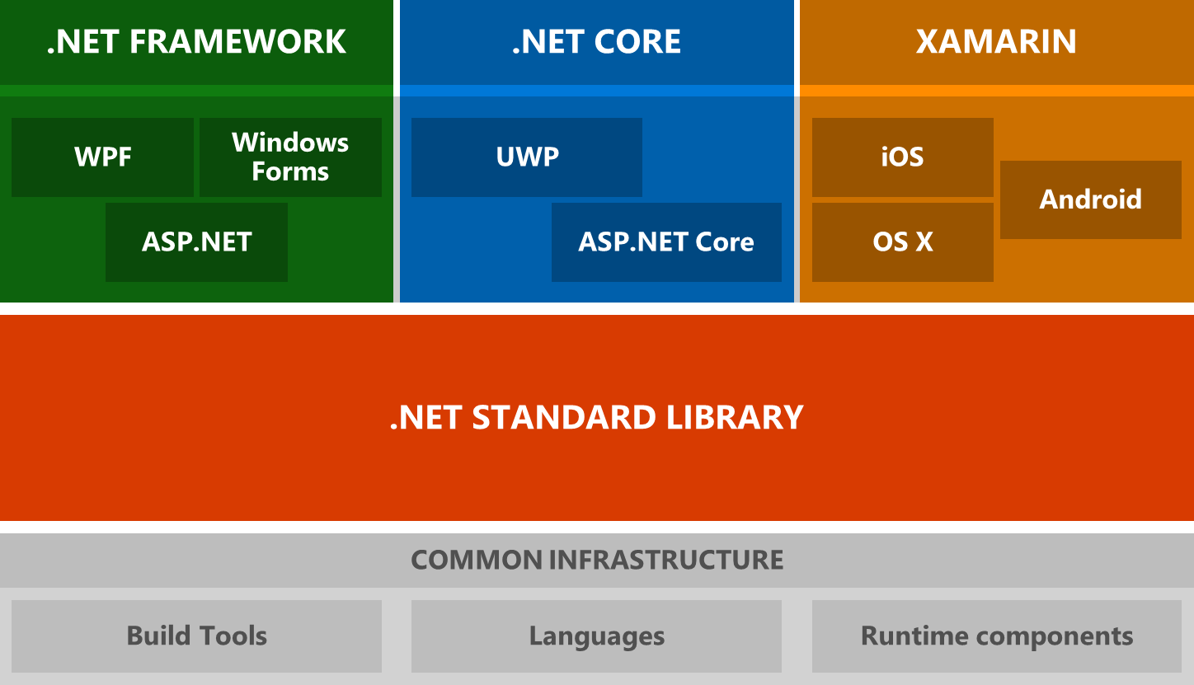
.NET Architectural Components
Notes:
.NET is made up of a number of key components. It has a standard library, called the .NET Standard Library, which is a large set of APIs which runs everywhere. This standard library is implemented by three .NET runtimes - .NET Framework, .NET Core, and Mono for Xamarin. The .NET languages also run on any .NET runtime. Additionally, there are tools on every platform which allow you to build projects. These tools are the same regardless of your choice of runtime.
Here's a graphical overview of each of the previously mentioned components of .NET and how they fit.
---------------------------------------------
.NET Standard Library
The .NET Standard Library is a set of APIs which are implemented by a .NET runtime.
More formally, it is a specification of .NET APIs which make up a uniform set of contracts that you compile your code against. These contracts have underlying implementations for each .NET runtime. This enables portability across different .NET runtimes, making it so that your code can effectively "run everywhere".
The .NET Standard Library is also a build target, where it is known as the .NET Standard. You can currently target .NET Standard 1.0-1.6. If your code targets a version of the .NET Standard, it is guaranteed to run on any .NET runtime which implements that version.
To learn more about the .NET Standard library and targeting the .NET Standard, see .NET Standard.
.NET runtimes
There are 3 primary .NET runtimes which Microsoft actively develops and maintains: .NET Core, .NET Framework, and Mono for Xamarin.
.NET Core
.NET Core is a cross-platform runtime optimized for server workloads. It implements the .NET Standard Library, which means that any code that targets the .NET Standard can run on .NET Core. It is the runtime used by ASP.NET Core and the Universal Windows Platform (UWP). It is modern, efficient, and designed to handle server and cloud workloads at scale.1
To learn more about .NET Core, see the .NET Core Guide.
.NET Framework
.NET Framework is the historical .NET runtime that has existed since 2002. It is the same .NET Framework existing .NET developers have always used. It implements the .NET Standard Library, which means that any code that targets the .NET Standard can run on the .NET Framework. It contains additional Windows-specific APIs, such as APIs for Windows desktop development with Windows Forms and WPF. .NET Framework is optimized for building Windows desktop applications.
To learn more about the .NET Framework, see the .NET Framework Guide.
Mono for Xamarin
Mono is the runtime used by Xamarin apps. It implements the .NET Standard Library, which means that any code that targets the .NET Standard can run on Xamarin apps. It contains additional APIs for iOS, Android, Xamarin.Forms, and Xamarin.Mac. It is optimized for building mobile applications on iOS and Android.
To learn more about Mono, see the Mono documentation.
.NET tooling and common infrastructure
Tooling for .NET is also common across each implementation of .NET. These include, but are not limited to:
The .NET languages and their compilers
Runtime components, such as the JIT and Garbage Collector
.NET project system (sometimes known as "csproj", "vbproj", or "fsproj")
MSBuild, the build engine used to build projects
NuGet, Microsoft's package manager for .NET
The .NET CLI, a cross-platform command-line interface for building .NET projects
Open Source build orchestration tools, such as CAKE and FAKE
The main takeaway here should be that there is a vast amount of tooling and infrastructure which is common for any "flavor" of .NET you choose to build your apps with.
---------------------------------------------
https://docs.microsoft.com/en-us/dotnet/standard/net-standard
https://docs.microsoft.com/en-us/dotnet/core/index

Slide 9
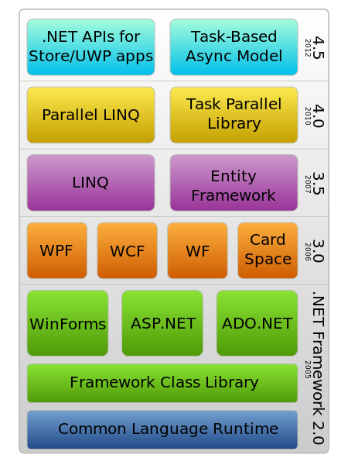
.NET Framework

Slide 10
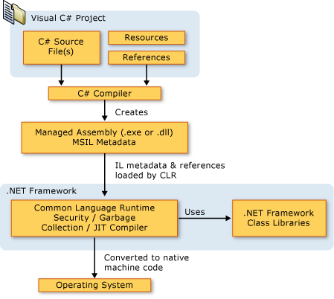
.NET Framework Platform Architecture
Notes:
C# programs run on the .NET Framework, an integral component of Windows that includes a virtual execution system called the common language runtime (CLR) and a unified set of class libraries. The CLR is the commercial implementation by Microsoft of the common language infrastructure (CLI), an international standard that is the basis for creating execution and development environments in which languages and libraries work together seamlessly.+
Source code written in C# is compiled into an intermediate language (IL) that conforms to the CLI specification. The IL code and resources, such as bitmaps and strings, are stored on disk in an executable file called an assembly, typically with an extension of .exe or .dll. An assembly contains a manifest that provides information about the assembly's types, version, culture, and security requirements.
When the C# program is executed, the assembly is loaded into the CLR, which might take various actions based on the information in the manifest. Then, if the security requirements are met, the CLR performs just in time (JIT) compilation to convert the IL code to native machine instructions. The CLR also provides other services related to automatic garbage collection, exception handling, and resource management. Code that is executed by the CLR is sometimes referred to as "managed code," in contrast to "unmanaged code" which is compiled into native machine language that targets a specific system. The following diagram illustrates the compile-time and run-time relationships of C# source code files, the .NET Framework class libraries, assemblies, and the CLR.
Language interoperability is a key feature of the .NET Framework. Because the IL code produced by the C# compiler conforms to the Common Type Specification (CTS), IL code generated from C# can interact with code that was generated from the .NET versions of Visual Basic, Visual C++, or any of more than 20 other CTS-compliant languages. A single assembly may contain multiple modules written in different .NET languages, and the types can reference each other just as if they were written in the same language.+
In addition to the run time services, the .NET Framework also includes an extensive library of over 4000 classes organized into namespaces that provide a wide variety of useful functionality for everything from file input and output to string manipulation to XML parsing, to Windows Forms controls. The typical C# application uses the .NET Framework class library extensively to handle common "plumbing" chores.
For more information about the .NET Framework, see Overview of the Microsoft .NET Framework.

Slide 11
Overview of the .NET Framework
To provide a consistent object-oriented programming environment whether object code is stored and executed locally, executed locally but Internet-distributed, or executed remotely.
To provide a code-execution environment that minimizes software deployment and versioning conflicts.
To provide a code-execution environment that promotes safe execution of code, including code created by an unknown or semi-trusted third party.
To provide a code-execution environment that eliminates the performance problems of scripted or interpreted environments.
To make the developer experience consistent across widely varying types of applications, such as Windows-based applications and Web-based applications.
To build all communication on industry standards to ensure that code based on the .NET Framework can integrate with any other code.
Notes:
The .NET Framework consists of the common language runtime and the .NET Framework class library. The common language runtime is the foundation of the .NET Framework. You can think of the runtime as an agent that manages code at execution time, providing core services such as memory management, thread management, and remoting, while also enforcing strict type safety and other forms of code accuracy that promote security and robustness. In fact, the concept of code management is a fundamental principle of the runtime. Code that targets the runtime is known as managed code, while code that does not target the runtime is known as unmanaged code. The class library is a comprehensive, object-oriented collection of reusable types that you can use to develop applications ranging from traditional command-line or graphical user interface (GUI) applications to applications based on the latest innovations provided by ASP.NET, such as Web Forms and XML Web services.
The .NET Framework can be hosted by unmanaged components that load the common language runtime into their processes and initiate the execution of managed code, thereby creating a software environment that can exploit both managed and unmanaged features. The .NET Framework not only provides several runtime hosts, but also supports the development of third-party runtime hosts.
For example, ASP.NET hosts the runtime to provide a scalable, server-side environment for managed code. ASP.NET works directly with the runtime to enable ASP.NET applications and XML Web services, both of which are discussed later in this topic.
Internet Explorer is an example of an unmanaged application that hosts the runtime (in the form of a MIME type extension). Using Internet Explorer to host the runtime enables you to embed managed components or Windows Forms controls in HTML documents. Hosting the runtime in this way makes managed mobile code possible, but with significant improvements that only managed code can offer, such as semi-trusted execution and isolated file storage.

Slide 12
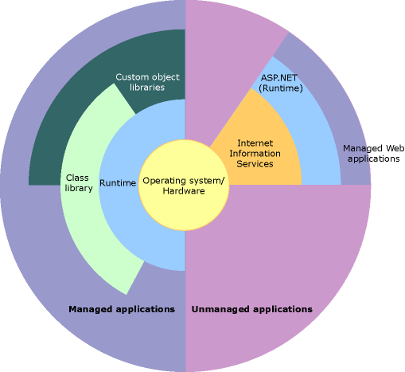
.NET Framework
Notes:
Features of the Common Language Runtime
The common language runtime manages memory, thread execution, code execution, code safety verification, compilation, and other system services. These features are intrinsic to the managed code that runs on the common language runtime.
With regards to security, managed components are awarded varying degrees of trust, depending on a number of factors that include their origin (such as the Internet, enterprise network, or local computer). This means that a managed component might or might not be able to perform file-access operations, registry-access operations, or other sensitive functions, even if it is being used in the same active application.
The runtime enforces code access security. For example, users can trust that an executable embedded in a Web page can play an animation on screen or sing a song, but cannot access their personal data, file system, or network. The security features of the runtime thus enable legitimate Internet-deployed software to be exceptionally feature rich.
The runtime also enforces code robustness by implementing a strict type-and-code-verification infrastructure called the common type system (CTS). The CTS ensures that all managed code is self-describing. The various Microsoft and third-party language compilers generate managed code that conforms to the CTS. This means that managed code can consume other managed types and instances, while strictly enforcing type fidelity and type safety.
In addition, the managed environment of the runtime eliminates many common software issues. For example, the runtime automatically handles object layout and manages references to objects, releasing them when they are no longer being used. This automatic memory management resolves the two most common application errors, memory leaks and invalid memory references.
The runtime also accelerates developer productivity. For example, programmers can write applications in their development language of choice, yet take full advantage of the runtime, the class library, and components written in other languages by other developers. Any compiler vendor who chooses to target the runtime can do so. Language compilers that target the .NET Framework make the features of the .NET Framework available to existing code written in that language, greatly easing the migration process for existing applications.
While the runtime is designed for the software of the future, it also supports software of today and yesterday. Interoperability between managed and unmanaged code enables developers to continue to use necessary COM components and DLLs.
The runtime is designed to enhance performance. Although the common language runtime provides many standard runtime services, managed code is never interpreted. A feature called just-in-time (JIT) compiling enables all managed code to run in the native machine language of the system on which it is executing. Meanwhile, the memory manager removes the possibilities of fragmented memory and increases memory locality-of-reference to further increase performance.
Finally, the runtime can be hosted by high-performance, server-side applications, such as Microsoft SQL Server and Internet Information Services (IIS). This infrastructure enables you to use managed code to write your business logic, while still enjoying the superior performance of the industry's best enterprise servers that support runtime hosting.

Slide 13
.NET Framework Class Library
Console applications. See Building Console Applications.
Windows GUI applications (Windows Forms). See Windows Forms.
Windows Presentation Foundation (WPF) applications. See Windows Presentation Foundation.
ASP.NET applications. See Web Applications with ASP.NET.
Windows services. See Introduction to Windows Service Applications.
Service-oriented applications using Windows Communication Foundation (WCF). See Service-Oriented Applications with WCF.
Workflow-enabled applications using Windows Workflow Foundation (WF). See Building Workflows in the .NET Framework.
Notes:
NET Framework Class Library
The .NET Framework class library is a collection of reusable types that tightly integrate with the common language runtime. The class library is object oriented, providing types from which your own managed code can derive functionality. This not only makes the .NET Framework types easy to use, but also reduces the time associated with learning new features of the .NET Framework. In addition, third-party components can integrate seamlessly with classes in the .NET Framework.
For example, the .NET Framework collection classes implement a set of interfaces that you can use to develop your own collection classes. Your collection classes will blend seamlessly with the classes in the .NET Framework.
As you would expect from an object-oriented class library, the .NET Framework types enable you to accomplish a range of common programming tasks, including tasks such as string management, data collection, database connectivity, and file access. In addition to these common tasks, the class library includes types that support a variety of specialized development scenarios. For example, you can use the .NET Framework to develop the following types of applications and services:
------------------------------
For example, the Windows Forms classes are a comprehensive set of reusable types that vastly simplify Windows GUI development. If you write an ASP.NET Web Form application, you can use the Web Forms classes.

Slide 14
Installation
https://docs.microsoft.com/en-us/dotnet/framework/install/on-windows-10
https://www.visualstudio.com/free-developer-offers/

Slide 15
Simple Windows Application
DEMO

Slide 16
Object-Oriented Programming in C#
Lesson 2
Using C# Predefined Types
Writing Expressions
Creating Conditional Statements
Creating Iteration Statements

Slide 17
Predefined types
The predefined reference types are object and string.
The predefined value types include signed and unsigned integral types, floating point types, and the types bool, char, and decimal.
The bool type is used to represent Boolean values: values that are either true or false.
The char type is used to represent Unicode characters. A variable of type char represents a single 16-bit Unicode character.
The decimal type is appropriate for calculations in which rounding errors caused by floating point representations are unacceptable.
Notes:
The predefined reference types are object and string. The type object is the ultimate base type of all other types. The type string is used to represent Unicode string values. Values of type string are immutable.
The predefined value types include signed and unsigned integral types, floating point types, and the types bool, char, and decimal. The signed integral types are sbyte, short, int, and long; the unsigned integral types are byte, ushort, uint, and ulong; and the floating point types are floatand double.
The bool type is used to represent Boolean values: values that are either true or false. The inclusion of bool makes it easier to write self-documenting code, and also helps eliminate the all-too-common C++ coding error in which a developer mistakenly uses "=" when "==" should have been used. In C#, the example
Common examples include financial calculations such as tax computations and currency conversions. The decimal type provides 28 significant digits.

Slide 18
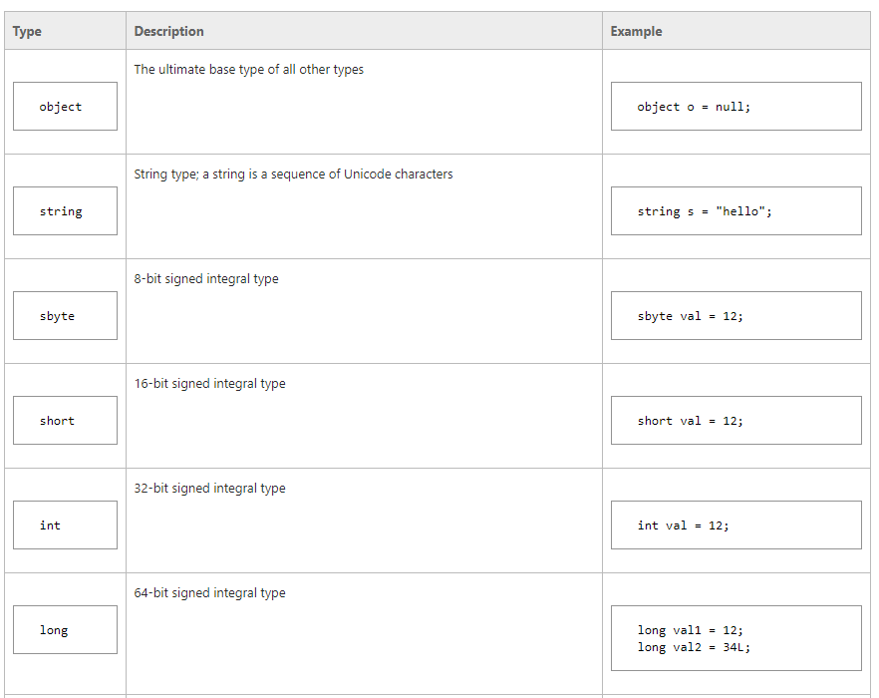
Predefined types
Notes:
The predefined reference types are object and string. The type object is the ultimate base type of all other types. The type string is used to represent Unicode string values. Values of type string are immutable.
The predefined value types include signed and unsigned integral types, floating point types, and the types bool, char, and decimal. The signed integral types are sbyte, short, int, and long; the unsigned integral types are byte, ushort, uint, and ulong; and the floating point types are floatand double.
The bool type is used to represent Boolean values: values that are either true or false. The inclusion of bool makes it easier to write self-documenting code, and also helps eliminate the all-too-common C++ coding error in which a developer mistakenly uses "=" when "==" should have been used. In C#, the example
Common examples include financial calculations such as tax computations and currency conversions. The decimal type provides 28 significant digits.

Slide 19
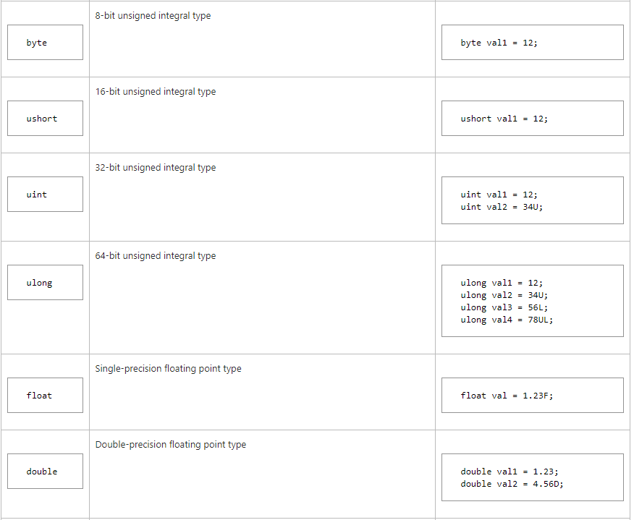
Predefined types
Notes:
The predefined reference types are object and string. The type object is the ultimate base type of all other types. The type string is used to represent Unicode string values. Values of type string are immutable.
The predefined value types include signed and unsigned integral types, floating point types, and the types bool, char, and decimal. The signed integral types are sbyte, short, int, and long; the unsigned integral types are byte, ushort, uint, and ulong; and the floating point types are floatand double.
The bool type is used to represent Boolean values: values that are either true or false. The inclusion of bool makes it easier to write self-documenting code, and also helps eliminate the all-too-common C++ coding error in which a developer mistakenly uses "=" when "==" should have been used. In C#, the example
Common examples include financial calculations such as tax computations and currency conversions. The decimal type provides 28 significant digits.

Slide 20
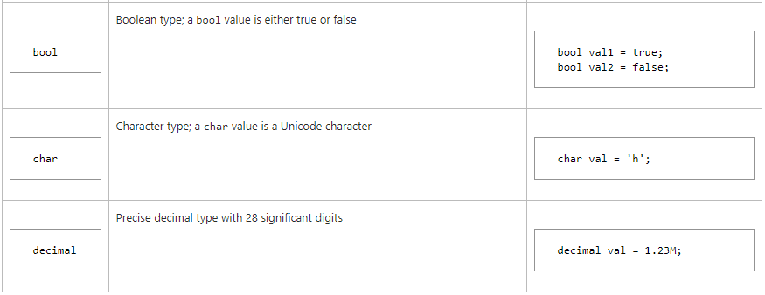
Predefined types
Notes:
The predefined reference types are object and string. The type object is the ultimate base type of all other types. The type string is used to represent Unicode string values. Values of type string are immutable.
The predefined value types include signed and unsigned integral types, floating point types, and the types bool, char, and decimal. The signed integral types are sbyte, short, int, and long; the unsigned integral types are byte, ushort, uint, and ulong; and the floating point types are floatand double.
The bool type is used to represent Boolean values: values that are either true or false. The inclusion of bool makes it easier to write self-documenting code, and also helps eliminate the all-too-common C++ coding error in which a developer mistakenly uses "=" when "==" should have been used. In C#, the example
Common examples include financial calculations such as tax computations and currency conversions. The decimal type provides 28 significant digits.

Slide 21
Predefined types
Each of the predefined types is shorthand for a system-provided type.
Predefined value types such as int are treated specially in a few ways but are for the most part treated exactly like other structs.
Notes:
Each of the predefined types is shorthand for a system-provided type. For example, the keyword int refers to the struct System.Int32. As a matter of style, use of the keyword is favored over use of the complete system type name.
Predefined value types such as int are treated specially in a few ways but are for the most part treated exactly like other structs. Operator overloading enables developers to define new struct types that behave much like the predefined value types. For instance, a Digit struct can support the same mathematical operations as the predefined integral types, and can define conversions between Digit and predefined types.

Slide 22
Predefined types
The predefined types employ operator overloading themselves. For example, the comparison operators == and != have different semantics for different predefined types:
Two expressions of type int are considered equal if they represent the same integer value.
Two expressions of type object are considered equal if both refer to the same object, or if both are null.
Two expressions of type string are considered equal if the string instances have identical lengths and identical characters in each character position, or if both are null.
Notes:
Each of the predefined types is shorthand for a system-provided type. For example, the keyword int refers to the struct System.Int32. As a matter of style, use of the keyword is favored over use of the complete system type name.
Predefined value types such as int are treated specially in a few ways but are for the most part treated exactly like other structs. Operator overloading enables developers to define new struct types that behave much like the predefined value types. For instance, a Digit struct can support the same mathematical operations as the predefined integral types, and can define conversions between Digit and predefined types.

Slide 23
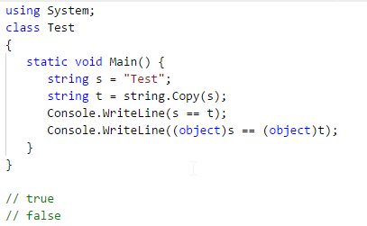
Predefined types
Notes:
The example produces the output because the first comparison compares two expressions of type string, and the second comparison compares two expressions of type object.

Slide 24
Common Type System
Establishes a framework that helps enable cross-language integration, type safety, and high-performance code execution.
Provides an object-oriented model that supports the complete implementation of many programming languages.
Defines rules that languages must follow, which helps ensure that objects written in different languages can interact with each other.
Provides a library that contains the primitive data types (such as Boolean, Byte, Char, Int32, and UInt64) used in application development.
Notes:
The common type system defines how types are declared, used, and managed in the common language runtime, and is also an important part of the runtime's support for cross-language integration. The common type system performs the following functions:

Slide 25
Types in .NET
Classes
Structures
Enumerations
Interfaces
Delegates
Notes:
A class is a reference type that can be derived directly from another class and that is derived implicitly from System.Object. The class defines the operations that an object (which is an instance of the class) can perform (methods, events, or properties) and the data that the object contains (fields). Although a class generally includes both definition and implementation (unlike interfaces, for example, which contain only definition without implementation), it can have one or more members that have no implementation.
--------------------------------
Class members that have no implementation are abstract members. A class that has one or more abstract members is itself abstract; new instances of it cannot be created. Some languages that target the runtime let you mark a class as abstract even if none of its members are abstract. You can use an abstract class when you want to encapsulate a basic set of functionality that derived classes can inherit or override when appropriate. Classes that are not abstract are referred to as concrete classes.
A class can implement any number of interfaces, but it can inherit from only one base class in addition to System.Object, from which all classes inherit implicitly. All classes must have at least one constructor, which initializes new instances of the class. If you do not explicitly define a constructor, most compilers will automatically provide a default (parameterless) constructor.
-------------------------------
Structures
A structure is a value type that derives implicitly from System.ValueType, which in turn is derived from System.Object. A structure is very useful for representing values whose memory requirements are small, and for passing values as by-value parameters to methods that have strongly typed parameters. In .NET, all primitive data types (Boolean, Byte, Char, DateTime, Decimal, Double, Int16, Int32, Int64, SByte, Single, UInt16, UInt32, and UInt64) are defined as structures.
Like classes, structures define both data (the fields of the structure) and the operations that can be performed on that data (the methods of the structure). This means that you can call methods on structures, including the virtual methods defined on the System.Object and System.ValueTypeclasses, and any methods defined on the value type itself. In other words, structures can have fields, properties, and events, as well as static and nonstatic methods. You can create instances of structures, pass them as parameters, store them as local variables, or store them in a field of another value type or reference type. Structures can also implement interfaces.
Value types also differ from classes in several respects. First, although they implicitly inherit from System.ValueType, they cannot directly inherit from any type. Similarly, all value types are sealed, which means that no other type can be derived from them. They also do not require constructors.
For each value type, the common language runtime supplies a corresponding boxed type, which is a class that has the same state and behavior as the value type. An instance of a value type is boxed when it is passed to a method that accepts a parameter of type System.Object. It is unboxed (that is, converted from an instance of a class back to an instance of a value type) when control returns from a method call that accepts a value type as a by-reference parameter. Some languages require that you use special syntax when the boxed type is required; others automatically use the boxed type when it is needed. When you define a value type, you are defining both the boxed and the unboxed type.
Enumerations
An enumeration (enum) is a value type that inherits directly from System.Enum and that supplies alternate names for the values of an underlying primitive type. An enumeration type has a name, an underlying type that must be one of the built-in signed or unsigned integer types (such as Byte, Int32, or UInt64), and a set of fields. The fields are static literal fields, each of which represents a constant. The same value can be assigned to multiple fields. When this occurs, you must mark one of the values as the primary enumeration value for reflection and string conversion.
You can assign a value of the underlying type to an enumeration and vice versa (no cast is required by the runtime). You can create an instance of an enumeration and call the methods of System.Enum, as well as any methods defined on the enumeration's underlying type. However, some languages might not let you pass an enumeration as a parameter when an instance of the underlying type is required (or vice versa).
The following additional restrictions apply to enumerations:
They cannot define their own methods.
They cannot implement interfaces.
They cannot define properties or events.
They cannot be generic, unless they are generic only because they are nested within a generic type. That is, an enumeration cannot have type parameters of its own.
The FlagsAttribute attribute denotes a special kind of enumeration called a bit field. The runtime itself does not distinguish between traditional enumerations and bit fields, but your language might do so. When this distinction is made, bitwise operators can be used on bit fields, but not on enumerations, to generate unnamed values. Enumerations are generally used for lists of unique elements, such as days of the week, country or region names, and so on. Bit fields are generally used for lists of qualities or quantities that might occur in combination, such as Red And Big And Fast.
The following example shows how to use both bit fields and traditional enumerations.

Slide 26
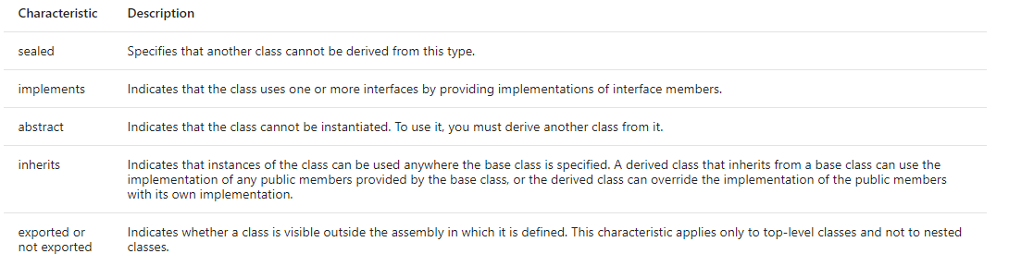
Classes
A class is a reference type that can be derived directly from another class and that is derived implicitly from System.Object.
Notes:
A class is a reference type that can be derived directly from another class and that is derived implicitly from System.Object.
The class defines the operations that an object (which is an instance of the class) can perform (methods, events, or properties) and the data that the object contains (fields). Although a class generally includes both definition and implementation (unlike interfaces, for example, which contain only definition without implementation), it can have one or more members that have no implementation.
The following table describes some of the characteristics that a class may have. Each language that supports the runtime provides a way to indicate that a class or class member has one or more of these characteristics. However, individual programming languages that target .NET may not make all these characteristics available.

Slide 27
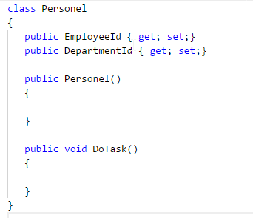
Class

Slide 28
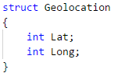
Structures
A structure is a value type that derives implicitly from System.ValueType, which in turn is derived from System.Object.
In .NET, all primitive data types (Boolean, Byte, Char, DateTime, Decimal, Double, Int16, Int32, Int64, SByte, Single, UInt16, UInt32, and UInt64) are defined as structures.
Notes:
A structure is a value type that derives implicitly from System.ValueType, which in turn is derived from System.Object. A structure is very useful for representing values whose memory requirements are small, and for passing values as by-value parameters to methods that have strongly typed parameters. In .NET, all primitive data types (Boolean, Byte, Char, DateTime, Decimal, Double, Int16, Int32, Int64, SByte, Single, UInt16, UInt32, and UInt64) are defined as structures.
Like classes, structures define both data (the fields of the structure) and the operations that can be performed on that data (the methods of the structure). This means that you can call methods on structures, including the virtual methods defined on the System.Object and System.ValueTypeclasses, and any methods defined on the value type itself. In other words, structures can have fields, properties, and events, as well as static and nonstatic methods. You can create instances of structures, pass them as parameters, store them as local variables, or store them in a field of another value type or reference type. Structures can also implement interfaces.+
Value types also differ from classes in several respects. First, although they implicitly inherit from System.ValueType, they cannot directly inherit from any type. Similarly, all value types are sealed, which means that no other type can be derived from them. They also do not require constructors.
For each value type, the common language runtime supplies a corresponding boxed type, which is a class that has the same state and behavior as the value type. An instance of a value type is boxed when it is passed to a method that accepts a parameter of type System.Object. It is unboxed (that is, converted from an instance of a class back to an instance of a value type) when control returns from a method call that accepts a value type as a by-reference parameter. Some languages require that you use special syntax when the boxed type is required; others automatically use the boxed type when it is needed. When you define a value type, you are defining both the boxed and the unboxed type.

Slide 29
Enumerations
An enumeration (enum) is a value type that inherits directly from System.Enum and that supplies alternate names for the values of an underlying primitive type.
An enumeration type has a name, an underlying type that must be one of the built-in signed or unsigned integer types (such as Byte, Int32, or UInt64), and a set of fields.
Notes:
An enumeration (enum) is a value type that inherits directly from System.Enum and that supplies alternate names for the values of an underlying primitive type. An enumeration type has a name, an underlying type that must be one of the built-in signed or unsigned integer types (such as Byte, Int32, or UInt64), and a set of fields. The fields are static literal fields, each of which represents a constant. The same value can be assigned to multiple fields. When this occurs, you must mark one of the values as the primary enumeration value for reflection and string conversion.
You can assign a value of the underlying type to an enumeration and vice versa (no cast is required by the runtime). You can create an instance of an enumeration and call the methods of System.Enum, as well as any methods defined on the enumeration's underlying type. However, some languages might not let you pass an enumeration as a parameter when an instance of the underlying type is required (or vice versa).

Slide 30
Enumerations
The following additional restrictions apply to enumerations:
They cannot define their own methods.
They cannot implement interfaces.
They cannot define properties or events.
They cannot be generic, unless they are generic only because they are nested within a generic type. That is, an enumeration cannot have type parameters of its own.

Slide 31
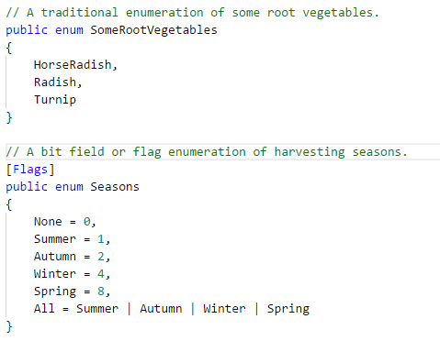
Enumerations
Notes:
The FlagsAttribute attribute denotes a special kind of enumeration called a bit field. The runtime itself does not distinguish between traditional enumerations and bit fields, but your language might do so. When this distinction is made, bitwise operators can be used on bit fields, but not on enumerations, to generate unnamed values. Enumerations are generally used for lists of unique elements, such as days of the week, country or region names, and so on. Bit fields are generally used for lists of qualities or quantities that might occur in combination, such as Red And Big And Fast.

Slide 32
Interfaces
An interface defines a contract that specifies a "can do" relationship or a "has a" relationship.
Interfaces are often used to implement functionality, such as comparing and sorting (the IComparable and IComparable<T> interfaces), testing for equality (the IEquatable<T> interface), or enumerating items in a collection (the IEnumerable and IEnumerable<T> interfaces).
Notes:
An interface defines a contract that specifies a "can do" relationship or a "has a" relationship. Interfaces are often used to implement functionality, such as comparing and sorting (the IComparable and IComparable<T> interfaces), testing for equality (the IEquatable<T> interface), or enumerating items in a collection (the IEnumerable and IEnumerable<T> interfaces). Interfaces can have properties, methods, and events, all of which are abstract members; that is, although the interface defines the members and their signatures, it leaves it to the type that implements the interface to define the functionality of each interface member. This means that any class or structure that implements an interface must supply definitions for the abstract members declared in the interface. An interface can require any implementing class or structure to also implement one or more other interfaces.

Slide 33
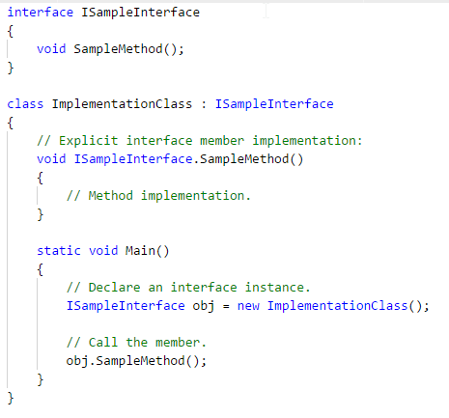
Interfaces
Notes:
An interface defines a contract that specifies a "can do" relationship or a "has a" relationship. Interfaces are often used to implement functionality, such as comparing and sorting (the IComparable and IComparable<T> interfaces), testing for equality (the IEquatable<T> interface), or enumerating items in a collection (the IEnumerable and IEnumerable<T> interfaces). Interfaces can have properties, methods, and events, all of which are abstract members; that is, although the interface defines the members and their signatures, it leaves it to the type that implements the interface to define the functionality of each interface member. This means that any class or structure that implements an interface must supply definitions for the abstract members declared in the interface. An interface can require any implementing class or structure to also implement one or more other interfaces.

Slide 34
Interfaces
The following restrictions apply to interfaces:
An interface can be declared with any accessibility, but interface members must all have public accessibility.
Interfaces cannot define constructors.
Interfaces cannot define fields.
Interfaces can define only instance members. They cannot define static members.

Slide 35
Delegates
Delegates are reference types that serve a purpose similar to that of function pointers in C++.
They are used for event handlers and callback functions in .NET.
Notes:
Delegates are reference types that serve a purpose similar to that of function pointers in C++. They are used for event handlers and callback functions in .NET. Unlike function pointers, delegates are secure, verifiable, and type safe. A delegate type can represent any instance method or static method that has a compatible signature.
A parameter of a delegate is compatible with the corresponding parameter of a method if the type of the delegate parameter is more restrictive than the type of the method parameter, because this guarantees that an argument passed to the delegate can be passed safely to the method.
Similarly, the return type of a delegate is compatible with the return type of a method if the return type of the method is more restrictive than the return type of the delegate, because this guarantees that the return value of the method can be cast safely to the return type of the delegate.
For example, a delegate that has a parameter of type IEnumerable and a return type of Object can represent a method that has a parameter of type Object and a return value of type IEnumerable. For more information and example code, see System.Delegate.CreateDelegate(Type, Object, MethodInfo).
A delegate is said to be bound to the method it represents. In addition to being bound to the method, a delegate can be bound to an object. The object represents the first parameter of the method, and is passed to the method every time the delegate is invoked. If the method is an instance method, the bound object is passed as the implicit this parameter (Me in Visual Basic); if the method is static, the object is passed as the first formal parameter of the method, and the delegate signature must match the remaining parameters. For more information and example code, see System.Delegate.
All delegates inherit from System.MulticastDelegate, which inherits from System.Delegate. The C#, Visual Basic, and C++ languages do not allow inheritance from these types. Instead, they provide keywords for declaring delegates.
Because delegates inherit from MulticastDelegate, a delegate has an invocation list, which is a list of methods that the delegate represents and that are executed when the delegate is invoked. All methods in the list receive the arguments supplied when the delegate is invoked.
In many cases, such as with callback methods, a delegate represents only one method, and the only actions you have to take are creating the delegate and invoking it.
For delegates that represent multiple methods, .NET provides methods of the Delegate and MulticastDelegate delegate classes to support operations such as adding a method to a delegate's invocation list (the System.Delegate.Combine method), removing a method (the System.Delegate.Remove method), and getting the invocation list (the System.Delegate.GetInvocationList method).

Slide 36
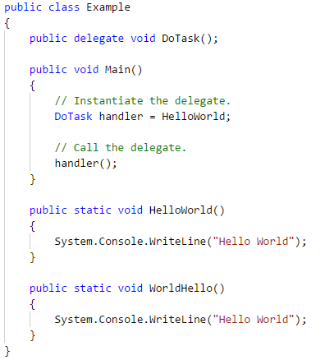
Delegates

Slide 37
Type Definitions
Any attributes defined on the type.
The type's accessibility (visibility).
The type's name.
The type's base type.
Any interfaces implemented by the type.
Definitions for each of the type's members.

Slide 38
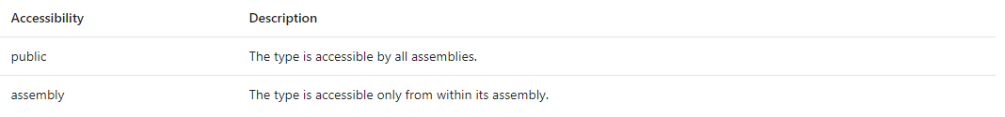
Attributes
Attributes provide additional user-defined metadata. Most commonly, they are used to store additional information about a type in its assembly, or to modify the behavior of a type member in either the design-time or run-time environment.
Notes:
Attributes are themselves classes that inherit from System.Attribute. Languages that support the use of attributes each have their own syntax for applying attributes to a language element. Attributes can be applied to almost any language element; the specific elements to which an attribute can be applied are defined by the AttributeUsageAttribute that is applied to that attribute class.
The accessibility of a nested type depends on its accessibility domain, which is determined by both the declared accessibility of the member and the accessibility domain of the immediately containing type. However, the accessibility domain of a nested type cannot exceed that of the containing type.
The accessibility domain of a nested member M declared in a type T within a program P is defined as follows (noting that M might itself be a type):
If the declared accessibility of M is public, the accessibility domain of M is the accessibility domain of T.
If the declared accessibility of M is protected internal, the accessibility domain of M is the intersection of the accessibility domain of T with the program text of P and the program text of any type derived from T declared outside P.
If the declared accessibility of M is protected, the accessibility domain of M is the intersection of the accessibility domain of T with the program text of T and any type derived from T.
If the declared accessibility of M is internal, the accessibility domain of M is the intersection of the accessibility domain of T with the program text of P.
If the declared accessibility of M is private, the accessibility domain of M is the program text of T.

Slide 39
Type Names
The common type system imposes only two restrictions on names:
All names are encoded as strings of Unicode (16-bit) characters.
Names are not permitted to have an embedded (16-bit) value of 0x0000.
Notes:
However, most languages impose additional restrictions on type names. All comparisons are done on a byte-by-byte basis, and are therefore case-sensitive and locale-independent.
Although a type might reference types from other modules and assemblies, a type must be fully defined within one .NET module. (Depending on compiler support, however, it can be divided into multiple source code files.) Type names need be unique only within a namespace. To fully identify a type, the type name must be qualified by the namespace that contains the implementation of the type.

Slide 40
Base Types and Interfaces
A type can inherit values and behaviors from another type. The common type system does not allow types to inherit from more than one base type.+
A type can implement any number of interfaces. To implement an interface, a type must implement all the virtual members of that interface. A virtual method can be implemented by a derived type and can be invoked either statically or dynamically.

Slide 41
Type Members
The runtime enables you to define members of your type, which specifies the behavior and state of a type. Type members include the following:
Fields
Properties
Methods
Constructors
Events
Nested types

Slide 42
Fields
A field describes and contains part of the type's state. Fields can be of any type supported by the runtime.
Most commonly, fields are either private or protected, so that they are accessible only from within the class or from a derived class.
If the value of a field can be modified from outside its type, a property set accessor is typically used.

Slide 43
Fields
Publicly exposed fields are usually read-only and can be of two types:
Constants, whose value is assigned at design time. These are static members of a class, although they are not defined using the static (Shared in Visual Basic) keyword.
Read-only variables, whose values can be assigned in the class constructor.

Slide 44
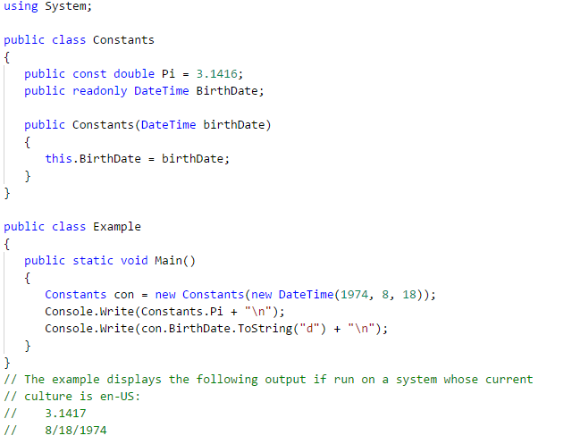
Fields

Slide 45
Properties
A property names a value or state of the type and defines methods for getting or setting the property's value.
Properties can be primitive types, collections of primitive types, user-defined types, or collections of user-defined types.
Properties are often used to keep the public interface of a type independent from the type's actual representation.
Notes:
A property names a value or state of the type and defines methods for getting or setting the property's value. Properties can be primitive types, collections of primitive types, user-defined types, or collections of user-defined types. Properties are often used to keep the public interface of a type independent from the type's actual representation. This enables properties to reflect values that are not directly stored in the class (for example, when a property returns a computed value) or to perform validation before values are assigned to private fields. The following example illustrates the latter pattern.+

Slide 46
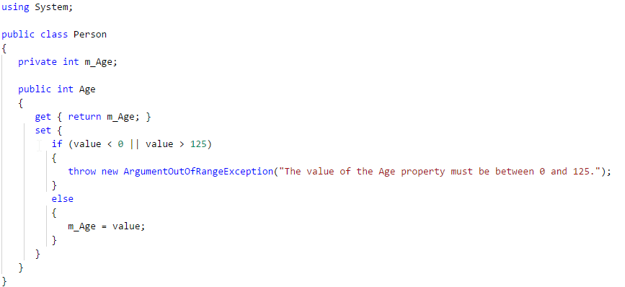
Properties
Notes:
In addition to including the property itself, the Microsoft intermediate language (MSIL) for a type that contains a readable property includes a get_propertyname method, and the MSIL for a type that contains a writable property includes a set_propertyname method.+

Slide 47
Methods
A method describes operations that are available on the type.
A method's signature specifies the allowable types of all its parameters and of its return value.
Notes:
A method describes operations that are available on the type. A method's signature specifies the allowable types of all its parameters and of its return value.+
Although most methods define the precise number of parameters required for method calls, some methods support a variable number of parameters. The final declared parameter of these methods is marked with the ParamArrayAttribute attribute. Language compilers typically provide a keyword, such as params in C# and ParamArray in Visual Basic, that makes explicit use of ParamArrayAttribute unnecessary.

Slide 48
Constructors
A constructor is a special kind of method that creates new instances of a class or structure.
Like any other method, a constructor can include parameters; however, constructors have no return value (that is, they return void).
If the source code for a class does not explicitly define a constructor, the compiler includes a default (parameterless) constructor.
Notes:
A constructor is a special kind of method that creates new instances of a class or structure. Like any other method, a constructor can include parameters; however, constructors have no return value (that is, they return void).
If the source code for a class does not explicitly define a constructor, the compiler includes a default (parameterless) constructor. However, if the source code for a class defines only parameterized constructors, the Visual Basic and C# compilers do not generate a parameterless constructor.
If the source code for a structure defines constructors, they must be parameterized; a structure cannot define a default (parameterless) constructor, and compilers do not generate parameterless constructors for structures or other value types. All value types do have an implicit default constructor. This constructor is implemented by the common language runtime and initializes all fields of the structure to their default values.

Slide 49
Events
An event defines an incident that can be responded to, and defines methods for subscribing to, unsubscribing from, and raising the event.
Events are often used to inform other types of state changes. For more information, see Events.
Notes:
A constructor is a special kind of method that creates new instances of a class or structure. Like any other method, a constructor can include parameters; however, constructors have no return value (that is, they return void).
If the source code for a class does not explicitly define a constructor, the compiler includes a default (parameterless) constructor. However, if the source code for a class defines only parameterized constructors, the Visual Basic and C# compilers do not generate a parameterless constructor.
If the source code for a structure defines constructors, they must be parameterized; a structure cannot define a default (parameterless) constructor, and compilers do not generate parameterless constructors for structures or other value types. All value types do have an implicit default constructor. This constructor is implemented by the common language runtime and initializes all fields of the structure to their default values.

Slide 50
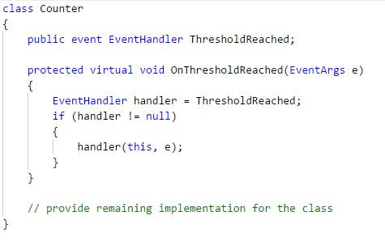
Events
Notes:
A constructor is a special kind of method that creates new instances of a class or structure. Like any other method, a constructor can include parameters; however, constructors have no return value (that is, they return void).
If the source code for a class does not explicitly define a constructor, the compiler includes a default (parameterless) constructor. However, if the source code for a class defines only parameterized constructors, the Visual Basic and C# compilers do not generate a parameterless constructor.
If the source code for a structure defines constructors, they must be parameterized; a structure cannot define a default (parameterless) constructor, and compilers do not generate parameterless constructors for structures or other value types. All value types do have an implicit default constructor. This constructor is implemented by the common language runtime and initializes all fields of the structure to their default values.

Slide 51
Nested Types
A nested type is a type that is a member of some other type.
Nested types should be tightly coupled to their containing type and must not be useful as a general-purpose type.
Nested types are useful when the declaring type uses and creates instances of the nested type, and use of the nested type is not exposed in public members.
Notes:
A nested type is a type that is a member of some other type. Nested types should be tightly coupled to their containing type and must not be useful as a general-purpose type. Nested types are useful when the declaring type uses and creates instances of the nested type, and use of the nested type is not exposed in public members.+
Nested types are confusing to some developers and should not be publicly visible unless there is a compelling reason for visibility. In a well-designed library, developers should rarely have to use nested types to instantiate objects or declare variables.

Slide 52
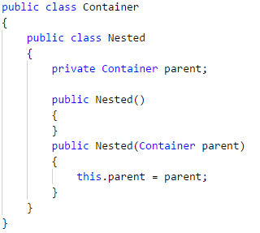
Nested Types
Notes:
Regardless of whether the outer type is a class or a struct, nested types default to private, but can be made public, protected internal, protected, internal, or private. In the previous example, Nested is inaccessible to external types, but can be made public like this:
The nested, or inner type can access the containing, or outer type. To access the containing type, pass it as a constructor to the nested type. For example:+
A nested type has access to all of the members that are accessible to its containing type. It can access private and protected members of the containing type, including any inherited protected members.
In the previous declaration, the full name of class Nested is Container.Nested. This is the name used to create a new instance of the nested class, as follows:

Slide 53
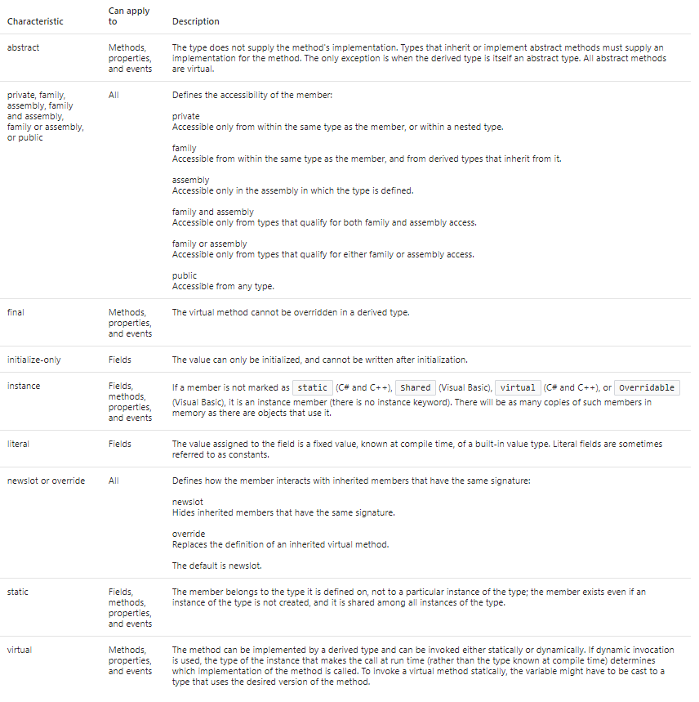
Characteristics of Type Members
Notes:
The common type system allows type members to have a variety of characteristics; however, languages are not required to support all these characteristics. The following table describes member characteristics.

Slide 54
Overloading
Each type member has a unique signature.
Method signatures consist of the method name and a parameter list (the order and types of the method's arguments).
Multiple methods with the same name can be defined within a type as long as their signatures differ.
When two or more methods with the same name are defined, the method is said to be overloaded. For example, in System.Char, the IsDigit method is overloaded. One method takes a Char. The other method takes a String and an Int32.

Slide 55
Inheriting, Overriding, and Hiding Members
A derived type inherits all members of its base type; that is, these members are defined on, and available to, the derived type. The behavior or qualities of inherited members can be modified in two ways:
A derived type can hide an inherited member by defining a new member with the same signature. This might be done to make a previously public member private or to define new behavior for an inherited method that is marked as final.
A derived type can override an inherited virtual method. The overriding method provides a new definition of the method that will be invoked based on the type of the value at run time rather than the type of the variable known at compile time. A method can override a virtual method only if the virtual method is not marked as final and the new method is at least as accessible as the virtual method.

Slide 56
Expressions
An expression is a sequence of one or more operands and zero or more operators that can be evaluated to a single value, object, method, or namespace.
Expressions can consist of a literal value, a method invocation, an operator and its operands, or a simple name.
Simple names can be the name of a variable, type member, method parameter, namespace or type.
Expressions can use operators that in turn use other expressions as parameters, or method calls whose parameters are in turn other method calls, so expressions can range from simple to very complex.

Slide 57

Expressions

Slide 58
Expression values
In most of the contexts in which expressions are used, for example in statements or method parameters, the expression is expected to evaluate to some value.
If x and y are integers, the expression x + y evaluates to a numeric value.
The expression new MyClass() evaluates to a reference to a new instance of a MyClass object. The expression myClass.ToString() evaluates to a string because that is the return type of the method.
Every value has an associated type. For example, if x and y are both variables of type int, the value of the expression x + y is also typed as int.
Notes:
In most of the contexts in which expressions are used, for example in statements or method parameters, the expression is expected to evaluate to some value. If x and y are integers, the expression x + y evaluates to a numeric value. The expression new MyClass() evaluates to a reference to a new instance of a MyClass object.
The expression myClass.ToString() evaluates to a string because that is the return type of the method.
However, although a namespace name is classified as an expression, it does not evaluate to a value and therefore can never be the final result of any expression. You cannot pass a namespace name to a method parameter, or use it in a new expression, or assign it to a variable.
You can only use it as a sub-expression in a larger expression. The same is true for types (as distinct from System.Type objects), method group names (as distinct from specific methods), and event add and remove accessors.
Every value has an associated type. For example, if x and y are both variables of type int, the value of the expression x + y is also typed as int. If the value is assigned to a variable of a different type, or if x and y are different types, the rules of type conversion are applied.
For more information about how such conversions work, see Casting and Type Conversions.

Slide 59
Overflows
Numeric expressions may cause overflows if the value is larger than the maximum value of the value's type.
The checked keyword is used to explicitly enable overflow checking for integral-type arithmetic operations and conversions. +
The unchecked keyword is used to suppress overflow-checking for integral-type arithmetic operations and conversions.

Slide 60
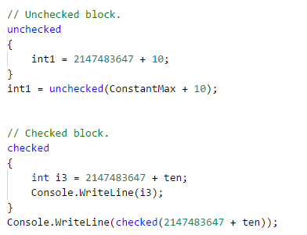
Overflows

Slide 61
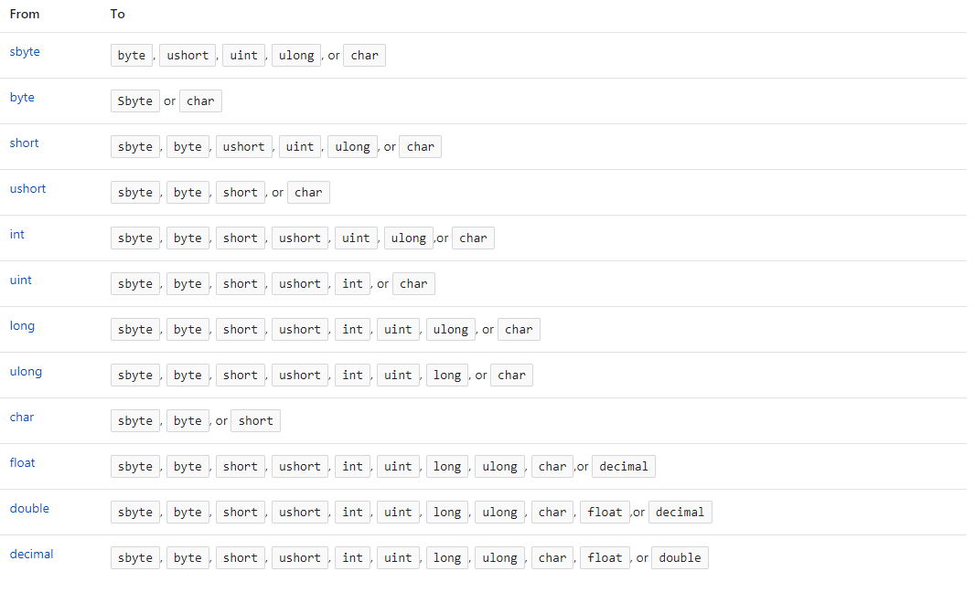
Explicit Numeric Conversions Table
Notes:
Explicit numeric conversion is used to convert any numeric type to any other numeric type, for which there is no implicit conversion, by using a cast expression. The following table shows these conversions.+

Slide 62
Operator
In C#, an operator is a program element that is applied to one or more operands in an expression or statement. Operators that take one operand, such as the increment operator (++) or new, are referred to as unary operators.
Operators that take two operands, such as arithmetic operators (+,-,*,/), are referred to as binary operators.
One operator, the conditional operator (?:), takes three operands and is the sole ternary operator in C#.

Slide 63
Operator
The following C# statement contains a single unary operator and a single operand. The increment operator, ++, modifies the value of the operand y.
The following C# statement contains two binary operators, each with two operands. The assignment operator, =, has the integer variable y and the expression 2 + 3 as operands. The expression 2 + 3 itself consists of the addition operator and two operands, 2 and 3.

Slide 64
Operator precedence and associativity
The manner in which an expression is evaluated is governed by the rules of associativity and operator precedence.

Slide 65
Operators, Evaluation, and Operator Precedence
An operand can be a valid expression that is composed of any length of code, and it can comprise any number of sub expressions. In an expression that contains multiple operators, the order in which the operators are applied is determined by operator precedence, associativity, and parentheses.
Each operator has a defined precedence. In an expression that contains multiple operators that have different precedence levels, the precedence of the operators determines the order in which the operators are evaluated.

Slide 66
Operator Precedence
For example, the following statement assigns 3 to n1
Notes:
The multiplication is executed first because multiplication takes precedence over subtraction.+

Slide 67
Operator Precedence
The following table separates the operators into categories based on the type of operation they perform. The categories are listed in order of precedence.

Slide 68
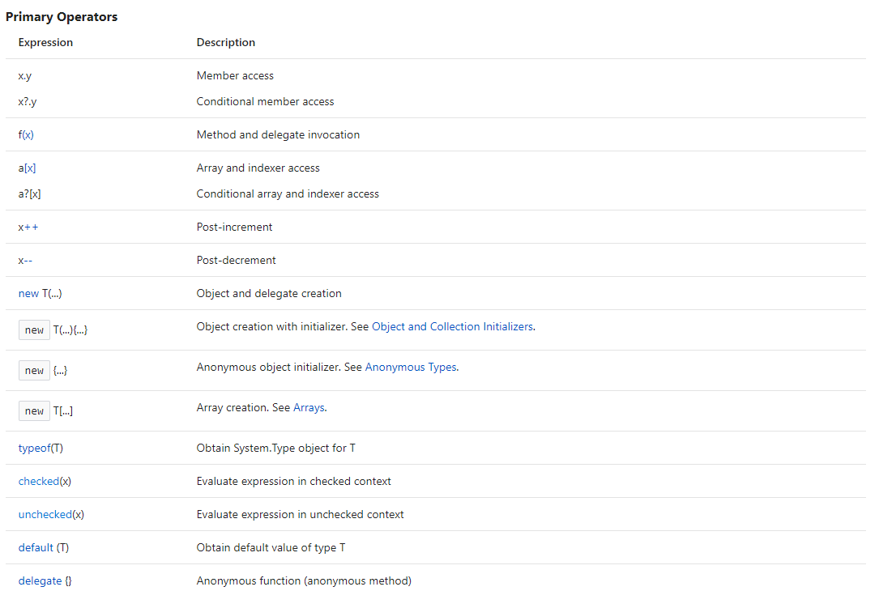
Operator Precedence

Slide 69
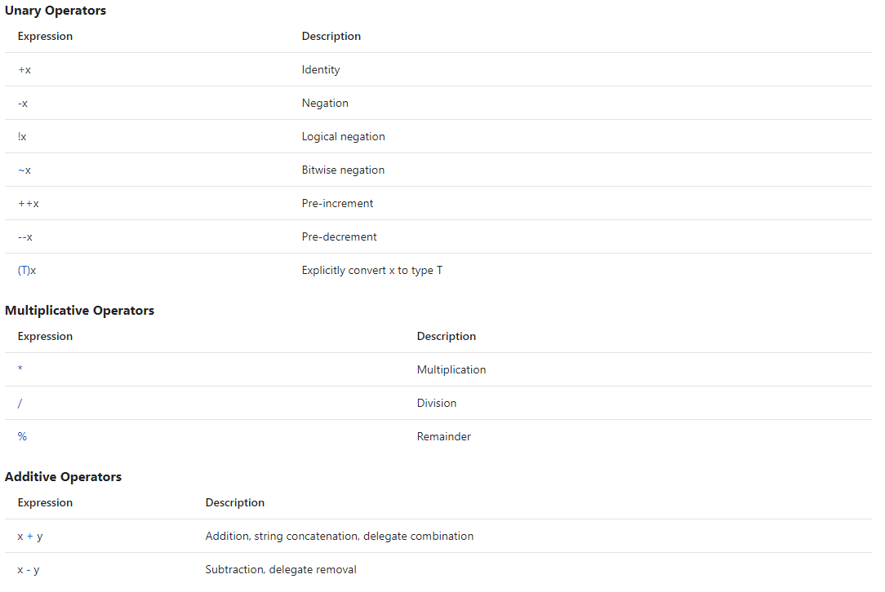
Operator Precedence

Slide 70
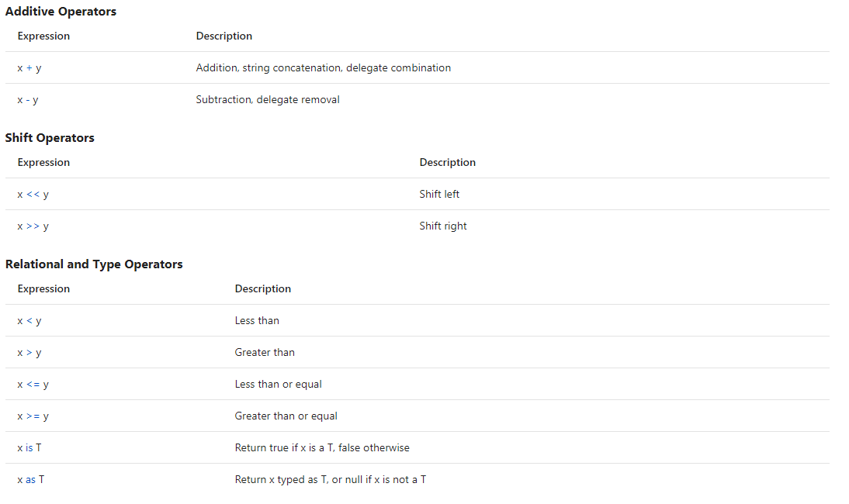
Operator Precedence

Slide 71
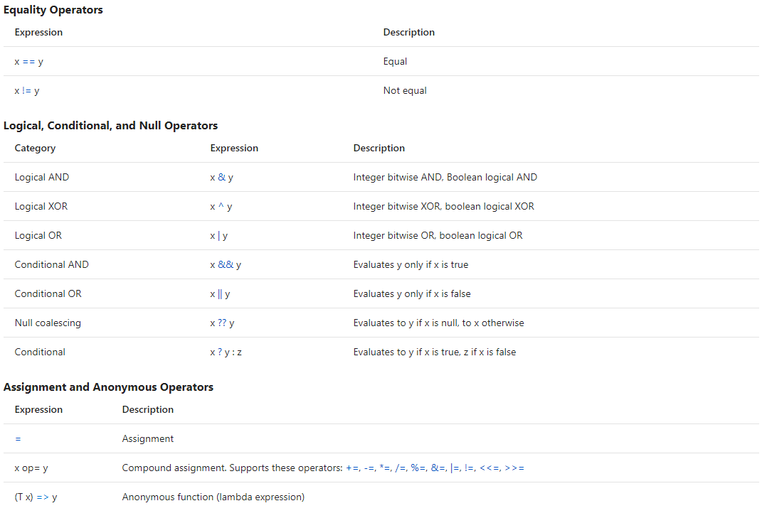
Operator Precedence

Slide 72
Associativity
When two or more operators that have the same precedence are present in an expression, they are evaluated based on associativity.
Left-associative operators are evaluated in order from left to right. For example, x * y / z is evaluated as (x * y) / z.
Right-associative operators are evaluated in order from right to left.

Slide 73
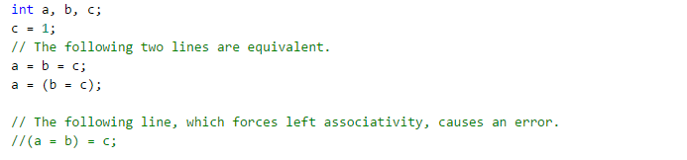
Associativity
For example, the assignment operator is right associative. If it were not, the following code would result in an error.

Slide 74
Associativity
As another example the ternary operator (?:) is right associative. Most binary operators are left associative.
Whether the operators in an expression are left associative or right associative, the operands of each expression are evaluated first, from left to right.

Slide 75
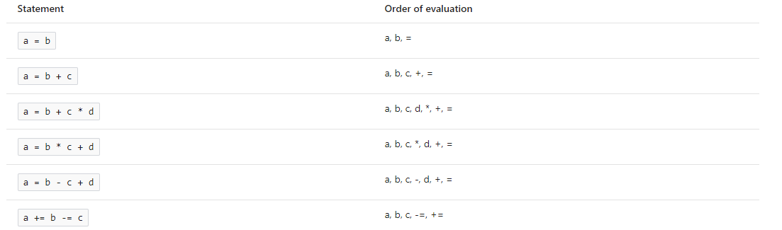
Associativity
The following examples illustrate the order of evaluation of operators and operands.

Slide 76
Adding Parentheses
You can change the order imposed by operator precedence and associativity by using parentheses.
For example, 2 + 3 * 2 ordinarily evaluates to 8, because multiplicative operators take precedence over additive operators.
However, if you write the expression as (2 + 3) * 2, the addition is evaluated before the multiplication, and the result is 10.

Slide 77
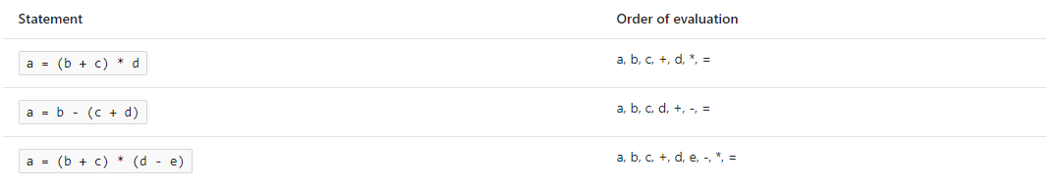
Adding Parentheses
The following examples illustrate the order of evaluation in parenthesized expressions. As in previous examples, the operands are evaluated before the operator is applied.

Slide 78
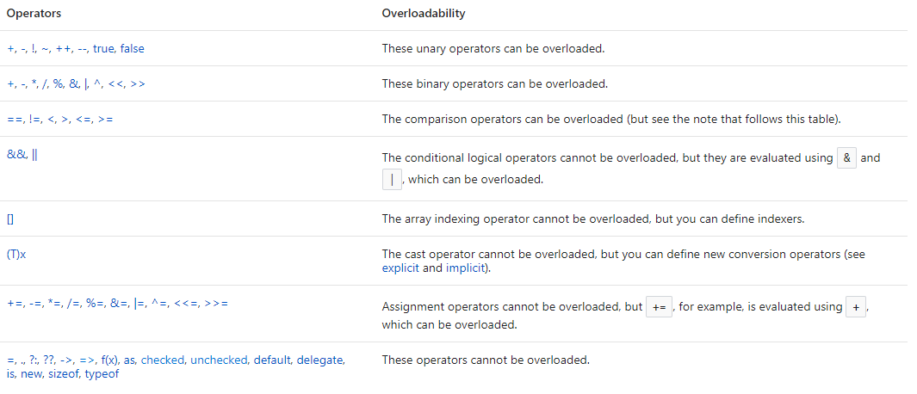
Operator Overloading
You can change the behavior of operators for custom classes and structs. This process is referred to as operator overloading.

Slide 79


Literals and simple names
The two simplest types of expressions are literals and simple names. A literal is a constant value that has no name. For example, in the following code example, both 5 and "Hello World" are literal values:
In the preceding example, both i and s are simple names that identify local variables. When those variables are used in an expression, the variable name evaluates to the value that is currently stored in the variable's location in memory. This is shown in the following example:

Slide 80
Invocation expressions
In the following code example, the call to DoWork is an invocation expression.
A method invocation requires the name of the method, either as a name as in the previous example, or as the result of another expression, followed by parenthesis and any method parameters.
A delegate invocation uses the name of a delegate and method parameters in parenthesis.
Method invocations and delegate invocations evaluate to the return value of the method, if the method returns a value.
Methods that return void cannot be used in place of a value in an expression.

Slide 81
Query expressions
Language-Integrated Query (LINQ) is the name for a set of technologies based on the integration of query capabilities directly into the C# language.
Query expressions are written in a declarative query syntax. By using query syntax, you can perform filtering, ordering, and grouping operations on data sources with a minimum of code.
Notes:
Language-Integrated Query (LINQ) is the name for a set of technologies based on the integration of query capabilities directly into the C# language.
Traditionally, queries against data are expressed as simple strings without type checking at compile time or IntelliSense support.
Furthermore, you have to learn a different query language for each type of data source: SQL databases, XML documents, various Web services, and so on. With LINQ, a query is a first-class language construct, just like classes, methods, events.
For a developer who writes queries, the most visible "language-integrated" part of LINQ is the query expression. Query expressions are written in a declarative query syntax. By using query syntax, you can perform filtering, ordering, and grouping operations on data sources with a minimum of code. You use the same basic query expression patterns to query and transform data in SQL databases, ADO .NET Datasets, XML documents and streams, and .NET collections.

Slide 82
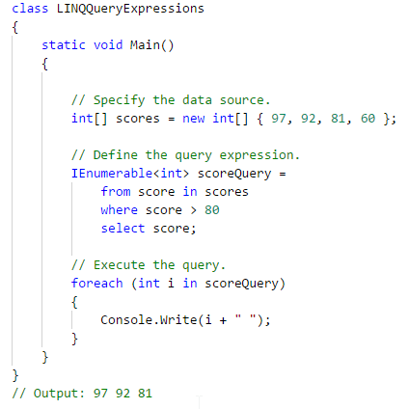
Query expressions
Notes:
Language-Integrated Query (LINQ) is the name for a set of technologies based on the integration of query capabilities directly into the C# language.
Traditionally, queries against data are expressed as simple strings without type checking at compile time or IntelliSense support.
Furthermore, you have to learn a different query language for each type of data source: SQL databases, XML documents, various Web services, and so on. With LINQ, a query is a first-class language construct, just like classes, methods, events.
For a developer who writes queries, the most visible "language-integrated" part of LINQ is the query expression. Query expressions are written in a declarative query syntax. By using query syntax, you can perform filtering, ordering, and grouping operations on data sources with a minimum of code. You use the same basic query expression patterns to query and transform data in SQL databases, ADO .NET Datasets, XML documents and streams, and .NET collections.

Slide 83
Query expression overview
Query expressions can be used to query and to transform data from any LINQ-enabled data source. For example, a single query can retrieve data from a SQL database, and produce an XML stream as output.
Query expressions are easy to master because they use many familiar C# language constructs.
The variables in a query expression are all strongly typed, although in many cases you do not have to provide the type explicitly because the compiler can infer it. For more information, see Type relationships in LINQ query operations.
A query is not executed until you iterate over the query variable, for example, in a foreach statement. For more information, see Introduction to LINQ queries.
Notes:
Language-Integrated Query (LINQ) is the name for a set of technologies based on the integration of query capabilities directly into the C# language.
Traditionally, queries against data are expressed as simple strings without type checking at compile time or IntelliSense support.
Furthermore, you have to learn a different query language for each type of data source: SQL databases, XML documents, various Web services, and so on. With LINQ, a query is a first-class language construct, just like classes, methods, events.
For a developer who writes queries, the most visible "language-integrated" part of LINQ is the query expression. Query expressions are written in a declarative query syntax. By using query syntax, you can perform filtering, ordering, and grouping operations on data sources with a minimum of code. You use the same basic query expression patterns to query and transform data in SQL databases, ADO .NET Datasets, XML documents and streams, and .NET collections.

Slide 84
Query expression overview
At compile time, query expressions are converted to Standard Query Operator method calls according to the rules set forth in the C# specification. Any query that can be expressed by using query syntax can also be expressed by using method syntax. However, in most cases query syntax is more readable and concise. For more information, see C# language specification and Standard query operators overview.
As a rule when you write LINQ queries, we recommend that you use query syntax whenever possible and method syntax whenever necessary. There is no semantic or performance difference between the two different forms. Query expressions are often more readable than equivalent expressions written in method syntax.
Some query operations, such as Count or Max, have no equivalent query expression clause and must therefore be expressed as a method call. Method syntax can be combined with query syntax in various ways. For more information, see Query syntax and method syntax in LINQ.
Notes:
Language-Integrated Query (LINQ) is the name for a set of technologies based on the integration of query capabilities directly into the C# language.
Traditionally, queries against data are expressed as simple strings without type checking at compile time or IntelliSense support.
Furthermore, you have to learn a different query language for each type of data source: SQL databases, XML documents, various Web services, and so on. With LINQ, a query is a first-class language construct, just like classes, methods, events.
For a developer who writes queries, the most visible "language-integrated" part of LINQ is the query expression. Query expressions are written in a declarative query syntax. By using query syntax, you can perform filtering, ordering, and grouping operations on data sources with a minimum of code. You use the same basic query expression patterns to query and transform data in SQL databases, ADO .NET Datasets, XML documents and streams, and .NET collections.

Slide 85
Query expression overview
Query expressions can be compiled to expression trees or to delegates, depending on the type that the query is applied to. IEnumerable<T> queries are compiled to delegates. IQueryable and IQueryable<T> queries are compiled to expression trees. For more information, see Expression trees.
Notes:
Language-Integrated Query (LINQ) is the name for a set of technologies based on the integration of query capabilities directly into the C# language.
Traditionally, queries against data are expressed as simple strings without type checking at compile time or IntelliSense support.
Furthermore, you have to learn a different query language for each type of data source: SQL databases, XML documents, various Web services, and so on. With LINQ, a query is a first-class language construct, just like classes, methods, events.
For a developer who writes queries, the most visible "language-integrated" part of LINQ is the query expression. Query expressions are written in a declarative query syntax. By using query syntax, you can perform filtering, ordering, and grouping operations on data sources with a minimum of code. You use the same basic query expression patterns to query and transform data in SQL databases, ADO .NET Datasets, XML documents and streams, and .NET collections.

Slide 86
Query expressions
Language-Integrated Query (LINQ) is the name for a set of technologies based on the integration of query capabilities directly into the C# language.
Traditionally, queries against data are expressed as simple strings without type checking at compile time or IntelliSense support.
Furthermore, you have to learn a different query language for each type of data source: SQL databases, XML documents, various Web services, and so on. With LINQ, a query is a first-class language construct, just like classes, methods, events.

Slide 87
Lambda expressions
A lambda expression is an anonymous function that you can use to create delegates or expression tree types.
By using lambda expressions, you can write local functions that can be passed as arguments or returned as the value of function calls.
Lambda expressions are particularly helpful for writing LINQ query expressions.
To create a lambda expression, you specify input parameters (if any) on the left side of the lambda operator =>, and you put the expression or statement block on the other side.

Slide 88
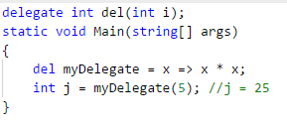
Lambda expressions
For example, the lambda expression x => x * x specifies a parameter that’s named x and returns the value of x squared. You can assign this expression to a delegate type, as the following example shows:

Slide 89
Lambda expressions
For example, the lambda expression x => x * x specifies a parameter that’s named x and returns the value of x squared. You can assign this expression to a delegate type, as the following example shows:
Notes:
The => operator has the same precedence as assignment (=) and is right associative (see "Associativity" section of the Operators article).+
Lambdas are used in method-based LINQ queries as arguments to standard query operator methods such as Where.
When you use method-based syntax to call the Where method in the Enumerable class (as you do in LINQ to Objects and LINQ to XML) the parameter is a delegate type System.Func<T,TResult>. A lambda expression is the most convenient way to create that delegate. When you call the same method in, for example, the System.Linq.Queryable class (as you do in LINQ to SQL) then the parameter type is an System.Linq.Expressions.Expression where Func is any of the Func delegates with up to sixteen input parameters. Again, a lambda expression is just a very concise way to construct that expression tree. The lambdas allow the Where calls to look similar although in fact the type of object created from the lambda is different.
In the previous example, notice that the delegate signature has one implicitly-typed input parameter of type int, and returns an int. The lambda expression can be converted to a delegate of that type because it also has one input parameter (x) and a return value that the compiler can implicitly convert to type int. (Type inference is discussed in more detail in the following sections.) When the delegate is invoked by using an input parameter of 5, it returns a result of 25.
Lambdas are not allowed on the left side of the is or as operator.
All restrictions that apply to anonymous methods also apply to lambda expressions. For more information, see Anonymous Methods.

Slide 90
Expression Lambdas
A lambda expression with an expression on the right side of the => operator is called an expression lambda. Expression lambdas are used extensively in the construction of Expression Trees.
An expression lambda returns the result of the expression and takes the following basic form:

Slide 91

Expression Lambdas
The parentheses are optional only if the lambda has one input parameter; otherwise they are required.
Two or more input parameters are separated by commas enclosed in parentheses:
Sometimes it is difficult or impossible for the compiler to infer the input types. When this occurs, you can specify the types explicitly as shown in the following exam

Slide 92
Expression Lambdas
The parentheses are optional only if the lambda has one input parameter; otherwise they are required.
Two or more input parameters are separated by commas enclosed in parentheses:
Sometimes it is difficult or impossible for the compiler to infer the input types. When this occurs, you can specify the types explicitly as shown in the following exam
Specify zero input parameters with empty parentheses:

Slide 93

Statement Lambdas
A statement lambda resembles an expression lambda except that the statement(s) is enclosed in braces:
The body of a statement lambda can consist of any number of statements; however, in practice there are typically no more than two or three.

Slide 94
Statements
The actions that a program takes are expressed in statements.
Common actions include declaring variables, assigning values, calling methods, looping through collections, and branching to one or another block of code, depending on a given condition.
The order in which statements are executed in a program is called the flow of control or flow of execution.
The flow of control may vary every time that a program is run, depending on how the program reacts to input that it receives at run time.

Slide 95
Statements
A statement can consist of a single line of code that ends in a semicolon, or a series of single-line statements in a block.
A statement block is enclosed in {} brackets and can contain nested blocks.
The following code shows two examples of single-line statements, and a multi-line statement block:

Slide 96
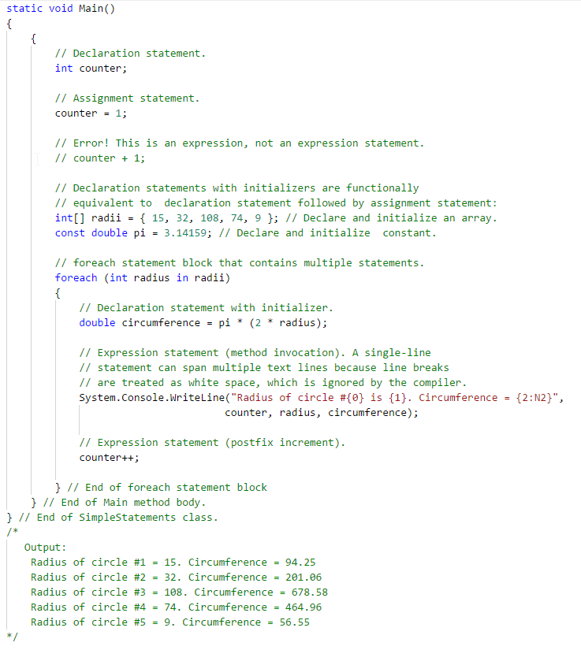
Statements

Slide 97
Types of Statements
The following table lists the various types of statements in C# and their associated keywords:

Slide 98
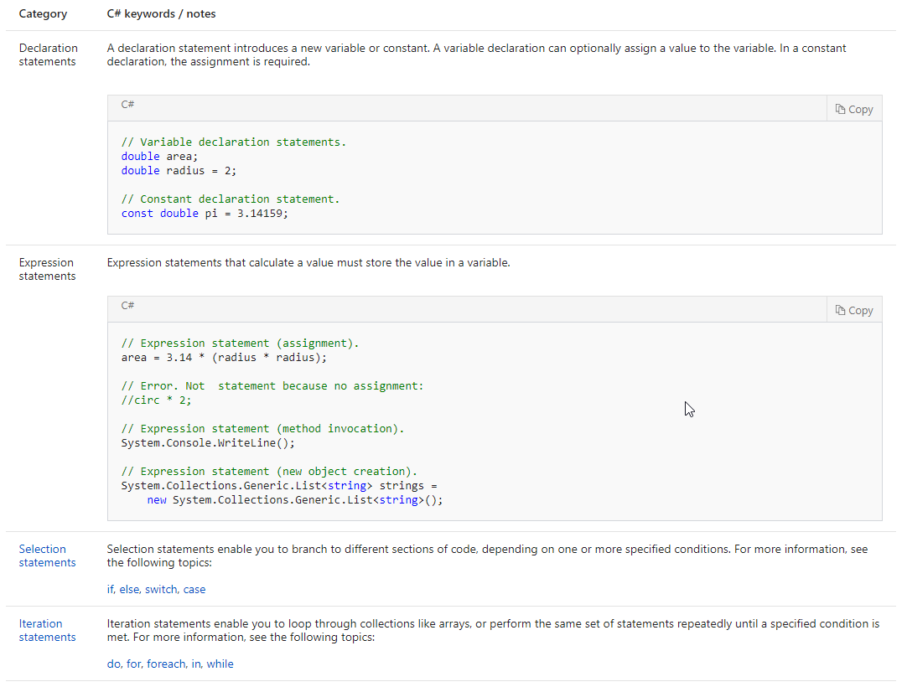
Types of Statements

Slide 99
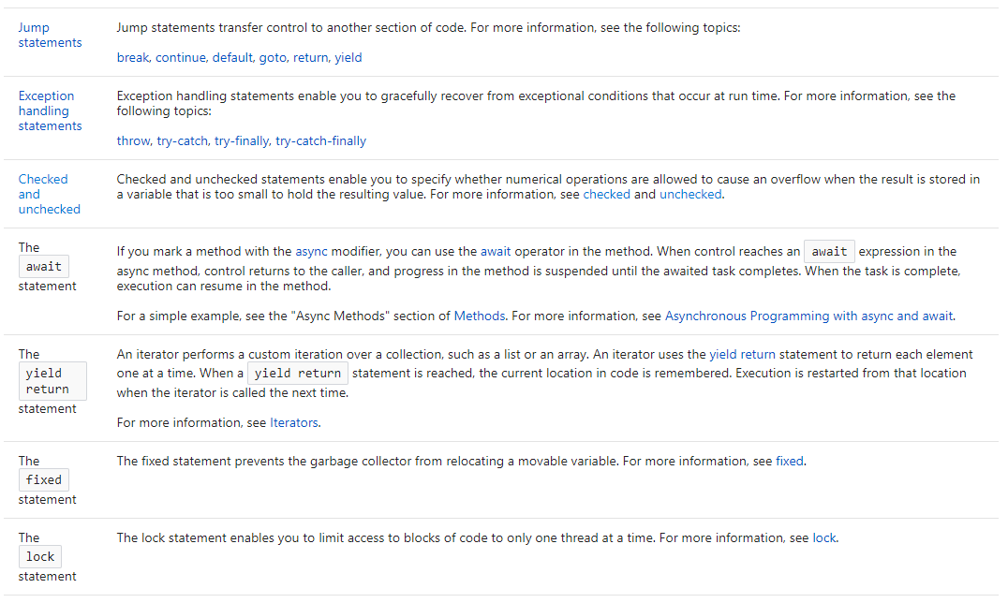
Types of Statements

Slide 100
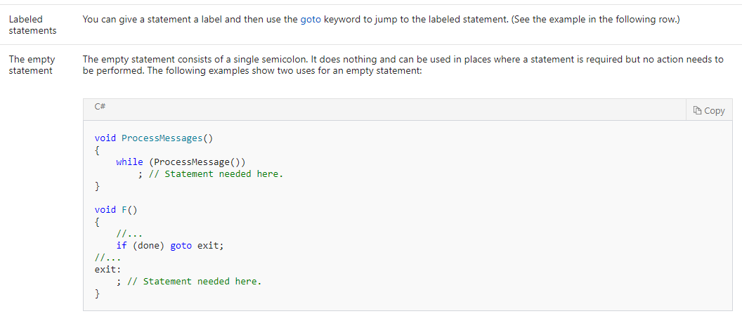
Types of Statements

Slide 101
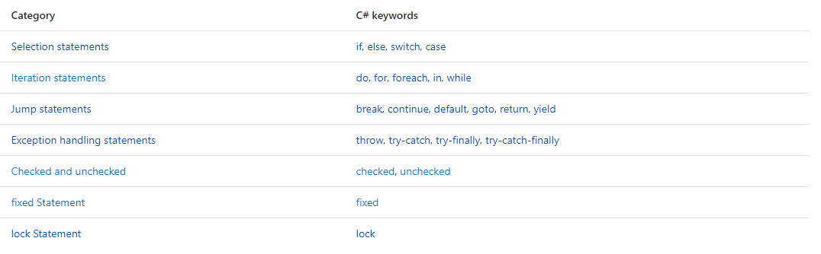
Statement Keywords
Statements are program instructions. Except as described in the topics referenced in the following table, statements are executed in sequence. The following table lists the C# statement keywords.

Slide 102
Embedded Statements
Some statements, including do, while, for, and foreach, always have an embedded statement that follows them.
This embedded statement may be either a single statement or multiple statements enclosed by {} brackets in a statement block.
Even single-line embedded statements can be enclosed in {} brackets

Slide 103
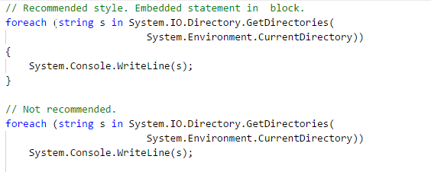
Embedded Statements

Slide 104

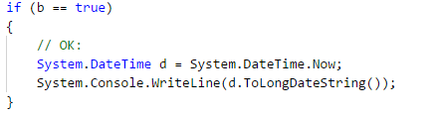
Embedded Statements
An embedded statement that is not enclosed in {} brackets cannot be a declaration statement or a labeled statement. This is shown in the following example:
Put the embedded statement in a block to fix the error:

Slide 105
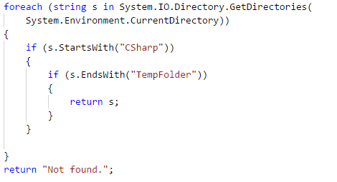
Nested Statement Blocks
Statement blocks can be nested, as shown in the following code:

Slide 106
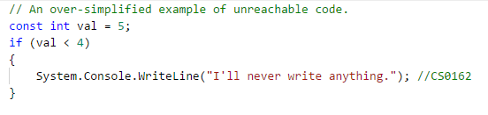
Unreachable Statements
If the compiler determines that the flow of control can never reach a particular statement under any circumstances, it will produce warning CS0162, as shown in the following example:

Slide 107
Unreachable Statements
If the compiler determines that the flow of control can never reach a particular statement under any circumstances, it will produce warning CS0162, as shown in the following example:

Slide 108
Expression-bodied members
Expression body definitions let you provide a member's implementation in a very concise, readable form.
You can use an expression body definition whenever the logic for any supported member, such as a method or property, consists of a single expression.
An expression body definition has the following general syntax:
where expression is a valid expression.

Slide 109

Expression-bodied members
Support for expression body definitions was introduced for methods and property get accessors in C# 6 and was expanded in C# 7. Expression body definitions can be used with the type members listed in the following table:+

Slide 110
Methods
An expression-bodied method consists of a single expression that returns a value whose type matches the method's return type, or, for methods that return void, that performs some operation.
For example, types that override the ToString method typically include a single expression that returns the string representation of the current object.

Slide 111
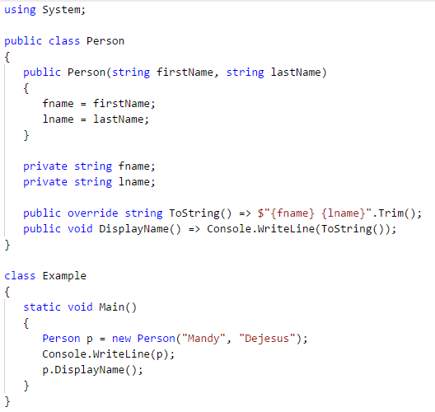
Methods

Slide 112
Constructors
An expression body definition for a constructor typically consists of a single assignment expression or a method call that handles the constructor's arguments or initializes instance state.
The following example defines a Location class whose constructor has a single string parameter named name. The expression body definition assigns the argument to the Name property.

Slide 113
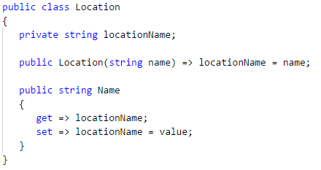
Constructors

Slide 114
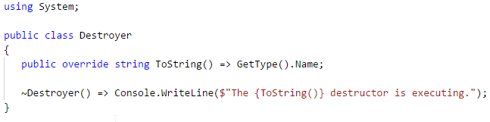
Finalizers
An expression body definition for a finalizer typically contains cleanup statements, such as statements that release unmanaged resources.
The following example defines a finalizer that uses an expression body definition to indicate that the finalizer has been called.

Slide 115
Property get / set statements
If you choose to implement a property get accessor yourself, you can use an expression body definition for single expressions that simply return the property value. Note that the return statement isn't used.
The following example defines a Location.Name property whose property get accessor returns the value of the private locationName field that backs the property.

Slide 116
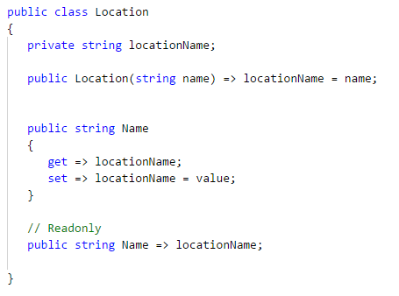
Property get / set statements

Slide 117
Indexers
Like properties, an indexer's get and set accessors consist of expression body definitions if the get accessor consists of a single statement that returns a value or the set accessor performs a simple assignment.
The following example defines a class named Sports that includes an internal String array that contains the names of a number of sports. Both the indexer's get and set accessors are implemented as expression body definitions.

Slide 118
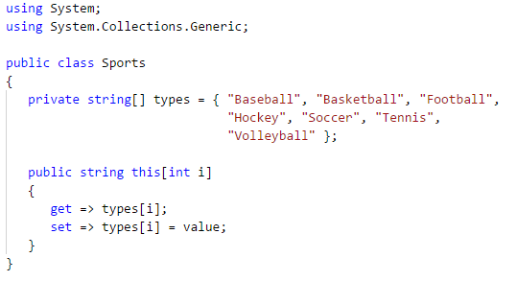
Indexers

Slide 119
Selection Statements
A selection statement causes the program control to be transferred to a specific flow based upon whether a certain condition is true or not.
The following keywords are used in selection statements:
if
else
switch
case
default

Slide 120
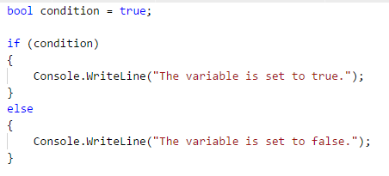
if-else
An if statement identifies which statement to run based on the value of a Boolean expression. In the following example, the Boolean variable result is set to true and then checked in the if statement. The output is The condition is true.

Slide 121
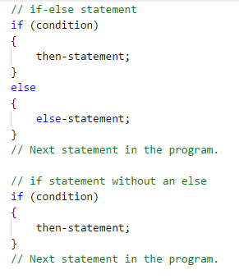
if-else
An if statement in C# can take two forms, as the following example shows. +

Slide 122
if-else
An if statement in C# can take two forms, as the following example shows. +
Notes:
In an if-else statement, if condition evaluates to true, the then-statement runs. If condition is false, the else-statement runs. Because condition can’t be simultaneously true and false, the then-statement and the else-statement of an if-else statement can never both run. After the then-statement or the else-statement runs, control is transferred to the next statement after the if statement.
In an if statement that doesn’t include an else statement, if condition is true, the then-statement runs. If condition is false, control is transferred to the next statement after the if statement.
Both the then-statement and the else-statement can consist of a single statement or multiple statements that are enclosed in braces ({}). For a single statement, the braces are optional but recommended.

Slide 123
if-else
An if statement in C# can take two forms, as the following example shows. +
Notes:
In an if-else statement, if condition evaluates to true, the then-statement runs. If condition is false, the else-statement runs. Because condition can’t be simultaneously true and false, the then-statement and the else-statement of an if-else statement can never both run. After the then-statement or the else-statement runs, control is transferred to the next statement after the if statement.
In an if statement that doesn’t include an else statement, if condition is true, the then-statement runs. If condition is false, control is transferred to the next statement after the if statement.
Both the then-statement and the else-statement can consist of a single statement or multiple statements that are enclosed in braces ({}). For a single statement, the braces are optional but recommended.

Slide 124
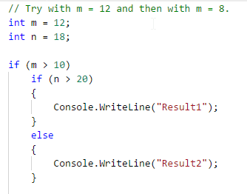
if-else
In nested if statements, each else clause belongs to the last if that doesn’t have a corresponding else. In the following example, Result1 appears if both m > 10 and n > 20 evaluate to true. If m > 10 is true but n > 20 is false, Result2 appears.
Notes:
In an if-else statement, if condition evaluates to true, the then-statement runs. If condition is false, the else-statement runs. Because condition can’t be simultaneously true and false, the then-statement and the else-statement of an if-else statement can never both run. After the then-statement or the else-statement runs, control is transferred to the next statement after the if statement.
In an if statement that doesn’t include an else statement, if condition is true, the then-statement runs. If condition is false, control is transferred to the next statement after the if statement.
Both the then-statement and the else-statement can consist of a single statement or multiple statements that are enclosed in braces ({}). For a single statement, the braces are optional but recommended.

Slide 125
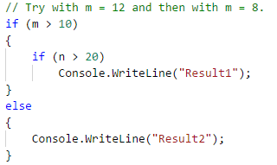
if-else
If, instead, you want Result2 to appear when (m > 10) is false, you can specify that association by using braces to establish the start and end of the nested if statement, as the following example shows.
Result2 appears if the condition (m > 10) evaluates to false.
Notes:
In an if-else statement, if condition evaluates to true, the then-statement runs. If condition is false, the else-statement runs. Because condition can’t be simultaneously true and false, the then-statement and the else-statement of an if-else statement can never both run. After the then-statement or the else-statement runs, control is transferred to the next statement after the if statement.
In an if statement that doesn’t include an else statement, if condition is true, the then-statement runs. If condition is false, control is transferred to the next statement after the if statement.
Both the then-statement and the else-statement can consist of a single statement or multiple statements that are enclosed in braces ({}). For a single statement, the braces are optional but recommended.

Slide 126

switch
switch is a selection statement that chooses a single switch section to execute from a list of candidates based on a pattern match with the match expression.
Notes:
In an if-else statement, if condition evaluates to true, the then-statement runs. If condition is false, the else-statement runs. Because condition can’t be simultaneously true and false, the then-statement and the else-statement of an if-else statement can never both run. After the then-statement or the else-statement runs, control is transferred to the next statement after the if statement.
In an if statement that doesn’t include an else statement, if condition is true, the then-statement runs. If condition is false, control is transferred to the next statement after the if statement.
Both the then-statement and the else-statement can consist of a single statement or multiple statements that are enclosed in braces ({}). For a single statement, the braces are optional but recommended.

Slide 127

switch
The switch statement is often used as an alternative to an if-else construct if a single expression is tested against three or more conditions. For example, the following switch statement determines whether a variable of type Color has one of three values:
Notes:
In an if-else statement, if condition evaluates to true, the then-statement runs. If condition is false, the else-statement runs. Because condition can’t be simultaneously true and false, the then-statement and the else-statement of an if-else statement can never both run. After the then-statement or the else-statement runs, control is transferred to the next statement after the if statement.
In an if statement that doesn’t include an else statement, if condition is true, the then-statement runs. If condition is false, control is transferred to the next statement after the if statement.
Both the then-statement and the else-statement can consist of a single statement or multiple statements that are enclosed in braces ({}). For a single statement, the braces are optional but recommended.

Slide 128

switch
It is equivalent to the following example that uses an if-else construct.
Notes:
In an if-else statement, if condition evaluates to true, the then-statement runs. If condition is false, the else-statement runs. Because condition can’t be simultaneously true and false, the then-statement and the else-statement of an if-else statement can never both run. After the then-statement or the else-statement runs, control is transferred to the next statement after the if statement.
In an if statement that doesn’t include an else statement, if condition is true, the then-statement runs. If condition is false, control is transferred to the next statement after the if statement.
Both the then-statement and the else-statement can consist of a single statement or multiple statements that are enclosed in braces ({}). For a single statement, the braces are optional but recommended.

Slide 129
switch
It is equivalent to the following example that uses an if-else construct.

Slide 130
switch
The default case specifies the switch section to execute if the match expression does not match any other case label. If a default case is not present and the match expression does not match any other case label, program flow falls through the switch statement.
The default case can appear in any order in the switch statement. Regardless of its order in the source code, it is always evaluated last, after all case labels have been evaluated.

Slide 131
switch
The default case specifies the switch section to execute if the match expression does not match any other case label. If a default case is not present and the match expression does not match any other case label, program flow falls through the switch statement.
The default case can appear in any order in the switch statement. Regardless of its order in the source code, it is always evaluated last, after all case labels have been evaluated.

Slide 132
Iteration Statements
You can create loops by using the iteration statements. Iteration statements cause embedded statements to be executed a number of times, subject to the loop-termination criteria. These statements are executed in order, except when a jump statement is encountered.
The following keywords are used in iteration statements:
do
for
foreach
in
while

Slide 133

do
The do statement executes a statement or a block of statements repeatedly until a specified expression evaluates to false.
The body of the loop must be enclosed in braces, {}, unless it consists of a single statement. In that case, the braces are optional.

Slide 134
do
The do statement executes a statement or a block of statements repeatedly until a specified expression evaluates to false.
The body of the loop must be enclosed in braces, {}, unless it consists of a single statement. In that case, the braces are optional.
Notes:
Unlike the while statement, a do-while loop is executed one time before the conditional expression is evaluated.+
At any point in the do-while block, you can break out of the loop using the break statement. You can step directly to the while expression evaluation statement by using the continue statement. If the while expression evaluates to true, execution continues at the first statement in the loop. If the expression evaluates to false, execution continues at the first statement after the do-while loop.
A do-while loop can also be exited by the goto, return, or throw statements.

Slide 135

for
By using a for loop, you can run a statement or a block of statements repeatedly until a specified expression evaluates to false.
This kind of loop is useful for iterating over arrays and for other applications in which you know in advance how many times you want the loop to iterate.
Notes:
The for statement in the previous example performs the following actions.
First, the initial value of variable i is established. This step happens only once, regardless of how many times the loop repeats. You can think of this initialization as happening outside the looping process.
To evaluate the condition (i <= 5), the value of i is compared to 5.
If i is less than or equal to 5, the condition evaluates to true, and the following actions occur.
The Console.WriteLine statement in the body of the loop displays the value of i.
The value of i is incremented by 1.
The loop returns to the start of step 2 to evaluate the condition again.
If i is greater than 5, the condition evaluates to false, and you exit the loop.
Note that, if the initial value of i is greater than 5, the body of the loop doesn't run even once.
Every for statement defines initializer, condition, and iterator sections. These sections usually determine how many times the loop iterates.

Slide 136

for
Every for statement defines initializer, condition, and iterator sections. These sections usually determine how many times the loop iterates. +
Notes:
The sections serve the following purposes.
The initializer section sets the initial conditions. The statements in this section run only once, before you enter the loop. The section can contain only one of the following two options.
The declaration and initialization of a local loop variable, as the first example shows (int i = 1). The variable is local to the loop and can't be accessed from outside the loop.
Zero or more statement expressons from the following list, separated by commas.
assignment statement
invocation of a method
prefix or postfix increment expression, such as ++i or i++
prefix or postfix decrement expression, such as --i or i--
creation of an object by using new
await expression
The condition section contains a boolean expression that’s evaluated to determine whether the loop should exit or should run again.
The iterator section defines what happens after each iteration of the body of the loop. The iterator section contains zero or more of the following statement expressions, separated by commas:
assignment statement
invocation of a method
prefix or postfix increment expression, such as ++i or i++
prefix or postfix decrement expression, such as --i or i--
creation of an object by using new
await expression
The body of the loop consists of a statement, an empty statement, or a block of statements, which you create by enclosing zero or more statements in braces.
You can break out of a for loop by using the break keyword, or you can step to the next iteration by using the continue keyword. You also can exit any loop by using a goto, return, or throw statement.
The first example in this topic shows the most typical kind of for loop, which makes the following choices for the sections.
The initializer declares and initializes a local loop variable, i, that maintains a count of the iterations of the loop.
The condition checks the value of the loop variable against a known final value, 5.
The iterator section uses a postfix increment statement, i++, to tally each iteration of the loop.

Slide 137

for
The following example illustrates several less common choices: assigning a value to an external loop variable in the initializer section, invoking the Console.WriteLine method in both the initializer and the iterator sections, and changing the values of two variables in the iterator section.
Notes:
The for statement in the previous example performs the following actions.
First, the initial value of variable i is established. This step happens only once, regardless of how many times the loop repeats. You can think of this initialization as happening outside the looping process.
To evaluate the condition (i <= 5), the value of i is compared to 5.
If i is less than or equal to 5, the condition evaluates to true, and the following actions occur.
The Console.WriteLine statement in the body of the loop displays the value of i.
The value of i is incremented by 1.
The loop returns to the start of step 2 to evaluate the condition again.
If i is greater than 5, the condition evaluates to false, and you exit the loop.
Note that, if the initial value of i is greater than 5, the body of the loop doesn't run even once.
Every for statement defines initializer, condition, and iterator sections. These sections usually determine how many times the loop iterates. The sections serve the following purposes.
The initializer section sets the initial conditions. The statements in this section run only once, before you enter the loop. The section can contain only one of the following two options.
The declaration and initialization of a local loop variable, as the first example shows (int i = 1). The variable is local to the loop and can't be accessed from outside the loop.
Zero or more statement expressons from the following list, separated by commas.
assignment statement
invocation of a method
prefix or postfix increment expression, such as ++i or i++
prefix or postfix decrement expression, such as --i or i--
creation of an object by using new
await expression
The condition section contains a boolean expression that’s evaluated to determine whether the loop should exit or should run again.
The iterator section defines what happens after each iteration of the body of the loop. The iterator section contains zero or more of the following statement expressions, separated by commas:
assignment statement
invocation of a method
prefix or postfix increment expression, such as ++i or i++
prefix or postfix decrement expression, such as --i or i--
creation of an object by using new
await expression
The body of the loop consists of a statement, an empty statement, or a block of statements, which you create by enclosing zero or more statements in braces.
You can break out of a for loop by using the break keyword, or you can step to the next iteration by using the continue keyword. You also can exit any loop by using a goto, return, or throw statement.
The first example in this topic shows the most typical kind of for loop, which makes the following choices for the sections.
The initializer declares and initializes a local loop variable, i, that maintains a count of the iterations of the loop.
The condition checks the value of the loop variable against a known final value, 5.
The iterator section uses a postfix increment statement, i++, to tally each iteration of the loop.

Slide 138

for
All of the expressions that define a for statement are optional. For example, the following statement creates an infinite loop.
Notes:
The for statement in the previous example performs the following actions.
First, the initial value of variable i is established. This step happens only once, regardless of how many times the loop repeats. You can think of this initialization as happening outside the looping process.
To evaluate the condition (i <= 5), the value of i is compared to 5.
If i is less than or equal to 5, the condition evaluates to true, and the following actions occur.
The Console.WriteLine statement in the body of the loop displays the value of i.
The value of i is incremented by 1.
The loop returns to the start of step 2 to evaluate the condition again.
If i is greater than 5, the condition evaluates to false, and you exit the loop.
Note that, if the initial value of i is greater than 5, the body of the loop doesn't run even once.
Every for statement defines initializer, condition, and iterator sections. These sections usually determine how many times the loop iterates. The sections serve the following purposes.
The initializer section sets the initial conditions. The statements in this section run only once, before you enter the loop. The section can contain only one of the following two options.
The declaration and initialization of a local loop variable, as the first example shows (int i = 1). The variable is local to the loop and can't be accessed from outside the loop.
Zero or more statement expressons from the following list, separated by commas.
assignment statement
invocation of a method
prefix or postfix increment expression, such as ++i or i++
prefix or postfix decrement expression, such as --i or i--
creation of an object by using new
await expression
The condition section contains a boolean expression that’s evaluated to determine whether the loop should exit or should run again.
The iterator section defines what happens after each iteration of the body of the loop. The iterator section contains zero or more of the following statement expressions, separated by commas:
assignment statement
invocation of a method
prefix or postfix increment expression, such as ++i or i++
prefix or postfix decrement expression, such as --i or i--
creation of an object by using new
await expression
The body of the loop consists of a statement, an empty statement, or a block of statements, which you create by enclosing zero or more statements in braces.
You can break out of a for loop by using the break keyword, or you can step to the next iteration by using the continue keyword. You also can exit any loop by using a goto, return, or throw statement.
The first example in this topic shows the most typical kind of for loop, which makes the following choices for the sections.
The initializer declares and initializes a local loop variable, i, that maintains a count of the iterations of the loop.
The condition checks the value of the loop variable against a known final value, 5.
The iterator section uses a postfix increment statement, i++, to tally each iteration of the loop.

Slide 139
foreach, in
The foreach statement repeats a group of embedded statements for each element in an array or an object collection that implements the System.Collections.IEnumerable or System.Collections.Generic.IEnumerable<T> interface.
The embedded statements continue to execute for each element in the array or collection.
At any point within the foreach block, you can break out of the loop by using the break keyword, or step to the next iteration in the loop by using the continue keyword.
A foreach loop can also be exited by the goto, return, or throw statements.
Notes:
The foreach statement repeats a group of embedded statements for each element in an array or an object collection that implements the System.Collections.IEnumerable or System.Collections.Generic.IEnumerable<T> interface. The foreach statement is used to iterate through the collection to get the information that you want, but can not be used to add or remove items from the source collection to avoid unpredictable side effects. If you need to add or remove items from the source collection, use a for loop.
The embedded statements continue to execute for each element in the array or collection. After the iteration has been completed for all the elements in the collection, control is transferred to the next statement following the foreach block.
At any point within the foreach block, you can break out of the loop by using the break keyword, or step to the next iteration in the loop by using the continue keyword.
A foreach loop can also be exited by the goto, return, or throw statements.

Slide 140
foreach, in
The following code shows three examples:
a typical foreach loop that displays the contents of an array of integers
a for loop that does the same thing
a foreach loop that maintains a count of the number of elements in the array
Notes:
The foreach statement repeats a group of embedded statements for each element in an array or an object collection that implements the System.Collections.IEnumerable or System.Collections.Generic.IEnumerable<T> interface. The foreach statement is used to iterate through the collection to get the information that you want, but can not be used to add or remove items from the source collection to avoid unpredictable side effects. If you need to add or remove items from the source collection, use a for loop.
The embedded statements continue to execute for each element in the array or collection. After the iteration has been completed for all the elements in the collection, control is transferred to the next statement following the foreach block.
At any point within the foreach block, you can break out of the loop by using the break keyword, or step to the next iteration in the loop by using the continue keyword.
A foreach loop can also be exited by the goto, return, or throw statements.

Slide 141

foreach, in
Notes:
The foreach statement repeats a group of embedded statements for each element in an array or an object collection that implements the System.Collections.IEnumerable or System.Collections.Generic.IEnumerable<T> interface. The foreach statement is used to iterate through the collection to get the information that you want, but can not be used to add or remove items from the source collection to avoid unpredictable side effects. If you need to add or remove items from the source collection, use a for loop.
The embedded statements continue to execute for each element in the array or collection. After the iteration has been completed for all the elements in the collection, control is transferred to the next statement following the foreach block.
At any point within the foreach block, you can break out of the loop by using the break keyword, or step to the next iteration in the loop by using the continue keyword.
A foreach loop can also be exited by the goto, return, or throw statements.

Slide 142

while
The while statement executes a statement or a block of statements until a specified expression evaluates to false.
Notes:
The foreach statement repeats a group of embedded statements for each element in an array or an object collection that implements the System.Collections.IEnumerable or System.Collections.Generic.IEnumerable<T> interface. The foreach statement is used to iterate through the collection to get the information that you want, but can not be used to add or remove items from the source collection to avoid unpredictable side effects. If you need to add or remove items from the source collection, use a for loop.
The embedded statements continue to execute for each element in the array or collection. After the iteration has been completed for all the elements in the collection, control is transferred to the next statement following the foreach block.
At any point within the foreach block, you can break out of the loop by using the break keyword, or step to the next iteration in the loop by using the continue keyword.
A foreach loop can also be exited by the goto, return, or throw statements.

Slide 143

while
Because the test of the while expression takes place before each execution of the loop, a while loop executes zero or more times. This differs from the do loop, which executes one or more times.
A while loop can be terminated when a break, goto, return, or throw statement transfers control outside the loop. To pass control to the next iteration without exiting the loop, use the continue statement. Notice the difference in output in the three previous examples, depending on where int n is incremented. In the example below no output is generated.
Notes:
The foreach statement repeats a group of embedded statements for each element in an array or an object collection that implements the System.Collections.IEnumerable or System.Collections.Generic.IEnumerable<T> interface. The foreach statement is used to iterate through the collection to get the information that you want, but can not be used to add or remove items from the source collection to avoid unpredictable side effects. If you need to add or remove items from the source collection, use a for loop.
The embedded statements continue to execute for each element in the array or collection. After the iteration has been completed for all the elements in the collection, control is transferred to the next statement following the foreach block.
At any point within the foreach block, you can break out of the loop by using the break keyword, or step to the next iteration in the loop by using the continue keyword.
A foreach loop can also be exited by the goto, return, or throw statements.

Slide 144
Assignment 1
Coverage
Lesson 1
Lesson 2

Slide 145
Assignment 1
Create a Windows Form Project
Create a Folder Model
Define a Struct^{[1]}, Enum^{[2]}, Interface^{[3]}, Class^{[4]}
On Class
Create example of
Expression^{[5]}, Expression-bodied Method^{[6]}, Statement^{[7]}
Delegate^{[8]}, Lambda^{[9]}, Linq^{[10]}
If-else^{[11]}, switch^{[12]}
for^{[13]}, foreach^{[14]}, do^{[15]}, while^{[16]}

Slide 146

Format
Use // TODO: <Number>

